Slide 1
MESC Conference on future electricity market challenges
8-9 October 2026
Ljubljana, ACER premises

Slide 2
Agenda

Slide 3
1.Opening session

Slide 4
Introduction
MESC members recently expressed concerns that ACER is not involving stakeholders early enough and thoroughly enough before making key decisions on market integration issues
During the last MESC meeting ACER announced the intention to organise a 1,5-day MESC conference on 8-9 October in Ljubljana
The aim of this meeting is twofold:
  Discuss and Identify a list of challenges/projects for the next 5-10 years that are deemed as key for stakeholders to fully integrate electricity markets
  Discuss the best way to involve stakeholders in tackling these challenges AHEAD of the legislation or decision-making processes*
The meeting will last 1,5 day and will be reserved to MESC members only (i.e. full MESC members and alternates)
Physical participation is highly recommended
* During the legislative or decision-making step, consultations will follow the normal process
Notes:
*

Slide 5
Enhanced stakeholder consultation
MESC stakeholder groups
POLICY
LEGISLATION
DECISIONS
IMPLEMENTATION
MONITORING
GOALS
Different areas and projects are in different stages of development

Slide 6
Conference agenda
Draft Agenda
Day 1 (14:00 – 17:30)
Welcome and introduction - 30 min
Future key challenges of the spot market (SDAC, SIDC) & capacity calculation – 120 min
Future key challenges of the forward market - 60 min
Day 2 (09:00 – 16:00)
Future key challenges of the balancing market - 60 min
Future key challenges of demand response & congestion management - 135 min
Future key challenges on governance and compliance - 75 min
Conclusions & way forward – 60 min

Slide 7
Preparatory material
Guidance to prepare for the workshop
Scope: the areas within the scope are specified in the agenda
How to identify challenges: see the supporting questions on the next slide
How to prepare the intervention/presentation: for each agenda item Stakeholders can indicate if they want to make an intervention. The max length of the interventions is 10-15 minutes and is accompanied by 2-3 slides (max)
How to keep consistent structure/approach across all areas: take the same approach (analysis, depth, ambition, timing, stakeholders’ involvement) across all areas

Slide 8
Focus areas and supporting questions
General question 1: What are the existing problems and future key challenges?
Specific questions
Market rules (rules governing market integration): What is needed to further enhance market integration and market efficiency? What is missing to achieve true energy union?
Access rules (terms and conditions for market access): Which access barriers need to be removed. Which access rules need to be simplified or abolished?
Harmonisation: Which market and access rules need EU harmonisation and why?
Timelines: By when the problem needs to be addressed and solutions implemented. How to ensure effective and timely implementation?
Governance (who does what?): Are there needs for new tasks and/or new entities? How should existing and new tasks be allocated to existing/new entities?
General question 2: What would be the best way to improve stakeholders’ involvement ahead of the legislative or decision-making process?

Slide 9
Conference format
Open exchange & debate
No formal/external conclusions
Chatham house rules
For on-line participants
  Mute when not speaking
  Introduce yourself before intervention

Slide 10
2. Evolution of the EU Internal Electricity Market
Preview of the next ACER Market integration report – November 2026

Slide 11
Market integration delivers significant benefits, with more to come

Slide 12
Market integration delivers billions in economic surplus
Economic surplus stemming from a selection of market integration projects* – 2025 (billion EUR)
The integration of electricity markets across the EU is central to achieving a secure, affordable, and sustainable power system.
An assessment of market integration projects* shows that:
Implemented projects delivered benefits of at least EUR 3 billion in 2025.
Further integration of electricity markets could have delivered an additional EUR 4 billion in 2025.
Delays in implementation led to EUR 700 million of foregone economic surplus in 2025
  EUR 8 billion cumulatively over 2020-2025.
Source: Upcoming ACER 2026 market monitoring report. Caveats and methodological limitations apply.
* List of market integration projects assessed: Long-term flow-based (Core CCR), Nordic flow-based in SDAC, Core flow-based in SDAC, TSOs accession to IGCC, Market-based allocation (Nordic CCR), 70% requirement (Core CCR), TSOs accession to MARI, TSOs accession to PICASSO, ROSC-RDCT (Central Europe CCR), Integration of Energy Community in SDAC, Flow-based allocation in IDAs (Core CCR), Bidding zone review, Co-optimisation.

Slide 13
Recent reforms increase spot market efficiency
Share of cross-zonal continuous intraday volumes by time to delivery on borders without derogations, normalised to 15-minute intervals (% of traded volume)
15-min MTUs allow market results to better reflect short-term variations in supply and demand.
15-min products account for ~88% of total traded volumes in day-ahead.
30-min IDCZGCT allows trade across bidding zones until 30 minutes before delivery.
~19% of cross-zonal XBID trading takes place during the final hour before delivery, where allowed.
Note: Hourly values are normalised to a 15-minute equivalent by dividing the share of traded volume in each hourly interval by four. The figure presents data for period 14 January to 30 April in 2025 and 2026.

Slide 14
Balancing integration delivers measurable benefits
aFRR price incidents decreased by 95%
Balancing-capacity cooperation creates value
The connection of additional TSOs and the implementation of elastic demand contributed to this decrease in price incidents.
Cross-border procurement increases the pool of available bids, while reserve sharing reduces the capacity that TSOs need to procure.
Annualised hours with aFRR prices beyond ±EUR 7,500/MWh
Estimated benefits by cooperation (EUR million)
Integration also strengthens system security
By pooling resources across borders, balancing platforms and balancing-capacity cooperations enabled additional balancing demand to be satisfied, therefore improving system security.
Sources: ACER calculations based on TransnetBW data and balancing capacity cooperations data and calculations.
Note: 2026 value for aFRR price incidents is annualised using data to 15 July. Cooperation estimates cover different periods.

Slide 15
Increasing congestion and the need to maximise capacities

Slide 16
Market congestion is increasing steadily
Cross-zonal trade plays a key role in ensuring the most efficient use of available resources.
Price differences are widening across the EU.
Growing congestion income signals the increasing value of cross-zonal trade.
Yearly average of the absolute price spread per bidding zone border in the day-ahead market – 2025 (EUR/MWh)
Yearly evolution of congestion income generated by SDAC – 2016-2025 (billion EUR)

Slide 17
Price divergence increases cross-zonal hedging needs
Growing price differences increase the need to hedge cross-zonal price risk.
Forward market liquidity remains concentrated in a small number of markets and declines significantly beyond one year ahead.
LTTRs enable market participants to access liquidity in neighbouring markets, where local liquidity is limited.
Yet LTTR prices appear consistently below the hedging value they provide -> more than EUR 2 billion* in net transfers from TSOs to LTTR holders over the last 10 years.
Churn rates in the main European forward markets – 2025
Net financial transfer between TSOs and LTTR holders – 2015-2026 (as % of total LTTR remuneration)
Note: Only on EU borders where FTRs are issued.

Slide 18
Maximising cross-zonal capacity becomes crucial
In a context of growing market congestion, the maximisation of capacities is increasingly valuable…
  …yet the process set up in the Electricity Regulation is far from complete.
Derogations based on excessive loop flows are still applied, leading to very low requirements on some CNECs.
Average minimum hourly margin available for cross-zonal trade* in the Core CCR per Member State – 2022-2025 (% of Fmax)
Overview of applicable minimum requirements in the Core CCR per Member State – 2025 (% of Fmax)
Note: This figure considers flows induced by third-country exchanges

Slide 19
Closer to real time, capacities are particularly scarce
Cross-zonal capacities become particularly limited closer to real time.
No minimum capacity level is currently maintained in intraday capacity calculation processes.
In flow-based regions, TSOs need to convert FB parameters into border-ATCs compatible with SIDC.
When extracting ATCs, only a conservative area of the FB domain can be retained.
Average monthly total ATCs in the Nordic CCR – 2024-2025 (MW)
% of MTUs with no net exchanges per bidding zone in IDA2 under flow-based allocation – 2025
Flow-based simulation
ATC-based results
Note: The metric shows the sum of capacity released in both directions of a given bidding zone border, averaged for the whole region. The capacity levels displayed for the period before the implementation of pan-European intraday auctions correspond to the cross-zonal capacity available for continuous trading at 15:00 D-1, 22:00 D-1 and 10:00 D.

Slide 20
Physical congestion is also growing across the EU
Evolution of RA volumes in the EU – 2021-2025 (TWh)
Growing trend detected in RDCT volumes (and costs) continues into 2025.
JRC forecasts a significant increase in RDCT activations under current grid buildout.
Increase in RDCT activations to safeguard voltage limits, specially in ES and PT.
Maximisation of cross-zonal capacities, without parallel structural measures, can exacerbate this trend.
RDCT: Redispatching and countertrading.

Slide 21
Integrating new flexible resources: benefits and barriers

Slide 22
New assets can lower costs and strengthen competition
Belgium: shorter products supported battery entry
Baltics: battery entry coincided with lower prices
Four-hour bids reached 100% of procured capacity as prices fell sharply and remained lower through 2026.
Average prices fell significantly; market concentration (HHI) decreased by 28–42%.
Positive aFRR capacity market, May 2022–May 2026
Simple average across Estonia, Latvia and Lithuania (EUR/MW/h)
New assets can lower costs and strengthen competition: Battery participation broadens the supplier side and can reduce reliance on conventional assets with higher commitment costs.
Sources: Belgium: ACER calculations based on Elia data.
Baltics: ACER calculations based on Baltic balancing-capacity market report. The values are simple averages across EE, LV and LT

Slide 23
Persistent barriers constrain demand response
Restrictive requirements to providing congestion management
Complex, lengthy, and discriminatory administrative requirements to provide flexibility
03
04
Restrictive requirements to providing balancing services
05
02
Lack of incentives for SOs to consider non-wire alternatives
Unavailability or lack of incentives to provide flexibility
06
01
…
Lack of a proper legal framework to allow market access
and the list goes on…
Notes:
- Multiple regulatory and market design barriers to demand response persist: difficulties to access markets, restrictive requirements to provide balancing or congestion management services, and the list goes on….
- Individually, each separate barrier might seem small in isolation. However, the sum of many small obstacles adds up to serious barriers impacting the overall market.

Slide 24
Thank you.
The contents of this document do not necessarily reflect the position or opinion of the Agency.
Notes:
I conclude with three messages:
First, market integration is already creating several billion euros of value, and there remains substantial potential from completing the projects that are still outstanding.
Second, increasing congestion makes cross-zonal capacity, efficient capacity allocation and effective cross-zonal hedging increasingly important.
- And third, integrating new flexible resources can lower costs and strengthen competition, but still barriers remain preventing those resources from participating fully.

Slide 25
3. Key Future Challenges for spot markets & Capacity Calculation
Stakeholder interventions (1h15)
ACER contribution & discussion (0.5h)

Slide 26
Order of Interventions
  EURELECTRIC - 10 minutes – Selim Bousetta
  ETE – 10 minutes - ?
  IFIEC – 5 minutes – Michael van Bossuyt (online)
  EUROPEX – 10 minutes – Arnold Weiss
  ENTSO-E -15 minutes – Tore Granli
  MCSC – 10 minutes – Andre Estermann
  NEMO Committee – 15 min - Rafael Gomez-Elvira
  ENCS – 5 minutes – Jasmina Trhulj
  1h15 minutes in total

Slide 27
Eurelectric views on key market coupling priorities
MESC conference on future electricity market challenges
08-09 October, Ljubljana

Slide 28
Market coupling relies on an enabling policy environment
Preserve and strengthen market-based electricity pricing
The European target model has shown its value: the priority consists in improving a market design that has shown to deliver under (i) self-dispatch, (ii) portfolio-based bidding, (iii) marginal pricing, (iv) technological neutrality and (v) market-based system services.
Support schemes need to complement rather than distort wholesale market functioning: public support is needed to cover investment gaps but can distort wholesale market prices and incentives if not well-designed (e.g. negative prices caused by ill-designed CfDs).
Technical and economically driven negative prices and/or price spikes are useful market signals: address the root causes rather than suppressing those prices.
Create a market framework that facilitates and optimises investments
Predictable market rules are key: debates about ad hoc market interventions (inframarginal rent taxes, price caps, design overhaul with low market acceptance etc.) hurt investor confidence and proper market signalling.
Free functioning of markets is key to reach optimal investment: access to a broad range of tools (spot and forward markets, PPAs, CRMs, and targeted public support such as CfDs) is key, and undue regulatory distortions should be avoided.
Deepen European market integration and governance
Prioritise projects reaping net benefits: the welfare gains of projects need to be assessed across timeframes, and possible side-effects must be addressed before go-live.
Effective governance arrangements support better delivery: thorough involvement of market participants as formal design partners rather than consulted stakeholders, and clear allocation of responsibilities for market coupling projects.
Transparency supports well functioning markets: full transparency on market inputs and outputs will improve market outcomes.

Slide 29
Market coupling relies on an enabling policy environment
Address grid and locational challenges pragmatically
Nodal pricing would create massive uncertainty: more targeted investment signals e.g. through connection charges or targeted bidding zone reviews can achieve similar objectives while preserving market confidence.
Congestion management needs to support wholesale markets: coordination of remedial actions will be key to lowering system costs and increasing cross-zonal capacities. Local flexibility markets should not negatively affect wholesale markets.
Enabling energy transition and resilience through market and infrastructures readiness
Market coupling infrastructure needs to match electrification ambitions: robustness of market coupling systems and fallbacks need to be assessed in light of market integration and electrification objectives.
Sufficient cross-zonal capacity also requires physical grid build-out: faster expansion including tackling bottlenecks within bidding zones requires anticipatory investments, streamlined permitting, faster grid connections, and continued digitalisation.

Slide 30
Network codes: key messages
01 CACM GL
02 FCA GL
03 EBGL
Market coupling is a European success story
Diagnosis before prescription
A sound foundation for the future
The core market architecture works.
Priority lies on extending best practices, completing key projects and improving delivery.
Liquidity pools and a broad range of hedging products are available.
Full analysis of root causes of perceived hedging insufficiencies before prescriptive proposals.
Market infrastructure is under completion.
Next step should be to leverage this maximally to build more integrated, more liquid and broadly participated markets.
Make future-proof checks on products, MP requirements and transparency.
Continuous improvement of market coupling systems and fallback arrangements.
Improving TSO coordination action and CZC availability.
LTTR design needs to support MPs’ overall hedging strategy.
Build policy in line with expressed, not presumed, market needs.
Build on efficient balancing platforms for liquid and transparent balancing markets.
Achieve a more seamless market where BSPs/BRPs compete on the same footing.

Slide 31
What are the key challenges for EU spot markets?
Spot
Remaining market coupling benefits are held back by lack of coordination and transparency
Lack of cross-zonal capacity: unequal progress towards the 70% target in day-ahead and issues resulting from uncoordinated capacity calculation approaches between regions and across timeframes.
The possible side effects of market coupling projects (flow-based) must be anticipated and mitigated – benefits of projects cannot be considered in isolation.
Lack of transparency: publication of market inputs and outputs is unequal across geographies and timeframes, impacting market participants’ ability to optimise their portfolios and destroying value.
Market participants need to understand TSO assumptions reducing CZC and to have access to harmonised, easily accessible and complete market data.
High-value projects progress too slowly: implementation of e.g. remedial actions coordination is delayed by cost considerations.
Pragmatism should be considered. Could requester-pays principle be a way to start things up?
Coupling infrastructure faces performance challenges: algorithm limitations in DA & ID increase risk of decouplings, while fallbacks still need improvement.
Maintaining trust in Europe’s reference electricity markets is crucial to Europe’s electrification strategy.
Market participants’ optimisation tools should not be restricted to accommodate new projects without a full assessment.

Slide 32
Proposals to future-proof spot markets
Spot
Lack of cross-zonal capacity
Implement FB in IDAs, ensuring that potential impacts on IDC and BAL are accounted for and minimised through accompanying measures.
Move to 30’ IDCZGCT to improve RES integration.
High-value projects progress too slowly
Implement sharing of remedial actions (ROSC, RDCT) to reduce the cost of congestions.
A transparent comparison of fallback alternatives has not been conducted, two years after the last decoupling incident.
Harmonise fallbacks at least at CCR level to ensure a single and economically relevant price in case of decoupling.
Lack of transparency on market inputs/outputs in some markets
Transparency on capacity calculation (inputs, remedial actions, capacity reductions).
Publish quarterly RCC reports on cross-zonal capacity reductions.
Improve communication on incidents and improve nomination arrangements.
Implement mandatory testing of new solutions with MPs.
Coupling infrastructure performance challenges
Involve MPs in the scoping and design of a future-proof IT infrastructure (scalability, resilience). A future-proof coupling infrastructure is MPs’ top priority.
Ensure corrective measures are proportionate, temporary and activation conditions are shared and justified.
Optimise SIDC performance and minimise continuous trading suspensions.
Looking ahead: how to further increase the value of market coupling
Geographical extension of market coupling: SDAC/SIDC expansion will support the energy transition and provide additional flexibility.
Implement net welfare testing: a holistic assessment of projects’ effects across timeframes needs to be conducted for new projects.

Slide 33
8-9 October 2026
ISKLJUČIVO PRIMATELJU
Market Stakeholder Committee
Ljubljana

Slide 34
Integrate by 28 - clear steps to complete the IEM
We need a common vision and a target model.
ISKLJUČIVO PRIMATELJU
We need it to:
Push in the same direction.
Focus on the long-term in addition to reactions.
Link the technical and the political.
Avoid distortive market interventions
Our Integrate by 28 Report, with 45 policy recommendations, show how deeper market integration can help Europe to become more independent, strengthen energy security, support industrial competitiveness and reach carbon neutrality at least cost.
Track progress at:

Slide 35
Existing problems and future key challenges
ISKLJUČIVO PRIMATELJU
Aim: ensure market development plans are clear, credible and beneficial
Consistent implementation of regulation remains a key challenge. While the target model is broadly accepted, recurring debates on relatively minor issues and shifts in priorities delay the full implementation even further.
The timelines of market integration projects are often overly ambitious. Greater stakeholder involvement at an earlier stage could help improve both feasibility and delivery. Greater transparencies can make parties more accountable.
The prioritisation of market integration projects does not always reflect their value to market participants. Decision-makers (EU and Member States) and NRAs/ACER should focus on measures that deliver the greatest welfare benefits.

Slide 36
Market rules
ISKLJUČIVO PRIMATELJU
Aim: improve rules and their implementation to unlock capacity for the market
We support harmonisation and integration across Europe when it creates value. Regionalisation can be enacted only when EU harmonisation destroys value.
Capacity calculation is identified as an important topic for further discussion – and potential inter-regional harmonisation.
A long-lasting and politically acceptable cost-sharing solution must be agreed – it is the key to unlock transmission capacity
More effective enforcement is needed to prevent Member States and TSOs from circumventing the intent of European legislation and regulations. NRAs should set up incentives for TSOs/NEMOs implementing regulation early and in the "right way".

Slide 37
Access rules
ISKLJUČIVO PRIMATELJU
Aim: include more participants from more markets, on a level-playing field
Pre-qualification requirements for market participation should be harmonised across Europe with balance between reliability and easy access for new entrants.
Licensing and excessive red tape can be an obstacle. See our obstacles to trading in SEE as an example. A plug and play approach to licensing across Europe is needed.
Expand the internal energy market (GB, CH, Energy Community) with concrete implementation plans to kickstart once political agreements are reached.

Slide 38
Timelines
ISKLJUČIVO PRIMATELJU
Aim: make timelines-setting an inclusive process that takes account of project interactions
Timelines need to be developed in close cooperation with market participants before legal or methodological options are narrowed down.
Overly ambitious deadlines can result in poor prioritisation and welfare and/or confidence losses, as resources are allocated to projects with the shortest deadlines rather than those delivering the greatest value to market.
MESC should become an early-warning, co-design and implementation-review mechanism, linked to concrete legislative and methodological workstreams and supported by transparent evidence

Slide 39
Spot markets
ISKLJUČIVO PRIMATELJU
Aim: preserve market coupling, improve its capacity to optimise, and ensure its long-term resilience
Preserve:
  No ad-hoc national/European interventions into pricing
  Clarify the role of market-based redispatch (or congestion services in general) in relation to wholesale markets
Improve:
  Cross-zonal intraday gate closure time should be as close to real time as possible.
  Strengthen transparency and phase-out derogations to reach the minimum 70% cross-zonal capacity requirement,
  Uniform specifications for the API interfaces connecting to the exchanges
Create resilience:
  SDAC fallback solution for full decoupling scenario should be setup
  IDAs performance issues need to be fixed. Shorter and harmonised suspension periods for SIDC continuous trading.
  Systems (both XBID and Euphemia) shall be prepared to manage increasing flows & complexity

Slide 40
IFIEC EUROPE
MESC Strategic Conference
8-9/10/2026 - Ljubljana

Slide 41
1. Key Future Challenges for spot markets & capacity calculation
The final goal remains market integration, not market coupling!
  Minimum 70%MinRAM ➔ Necessary proxy target to evolve towards and achieve market integration
  Algorithmic limits and complexity are real challenges and barriers to entry
  Need for transparency and as little as possible exceptions to the algorithm (cf. IVAs, …)
Integrate all borders in Europe in the algorithm to increase the overall social welfare and ensure an optimal allocation of flows
  Borders not yet covered by the single algorithm (cf. France-Italy North borders ➔ ACER should consider to impose measures, e.g. max Fuaf of 20%)
  Implicit allocation on all borders (cf. Switzerland)
  Integration of UK borders?
41

Slide 42
1. Key Future Challenges for spot markets & capacity calculation
Intraday
  Pending regulatory approvals for Intraday Auctions ➔ How to ensure a strong ID price signal!?
  Intraday liquidity and bottlenecks, including capacity calculation and allocation
  Co-optimization discussion ➔ Impact on (DA and) ID markets?!
Energy-Only vs. CRM subsidized capacities ➔ distort localized spot market price signals ➔ hampers pure spot market development and leads to technology biases
42

Slide 43
Spot Markets
Ljubljana October 2026

Slide 44
Spot Markets
Policy Recommendations
Fully leverage the benefits
of the
internal energy market
Maximising available cross-zonal capacity for day-ahead and intraday electricity trading.
Full and timely implementation of existing and upcoming legislation
Maintain Uniform Pricing and zonal design
Extension of the
Internal Energy Market Beyond the EU’s Borders
Full integration of the Energy Community, Great Britain and Switzerland into the rules and framework of the Internal Energy Market. Support the extension of the single market coupling to bidding zones outside the EU.
Build Technology-Neutral Markets That Are
Fit for the Future
Price of energy or the respective underlying commodity should remain the central award criterion, gradual phase-out of subsidies
Efficient, compatible framework conditions and targets to ensure sufficient investment; special focus on emerging commodities

Slide 45
Stakeholder Involvemnet
Improvements
Consultation Periods
Four week minimum after introductory seminars with consideration of parliamentary holidays
Treatment of feedback
Address feedbacks, be transparent in assessment explaining inclusion or disregard
Early Involvement
Targeted, closed consultations as well as preparatory discussions in smaller expert groups - ahead of drafting

Slide 46
Future key challenges of the SDAC, SIDC & capacity calculation
8 October

Slide 47
Key messages
ENTSO-E supports an ambitious and future-proof legal framework that strengthens market integration while preserving operational security, clear accountability and realistic implementation.
Operational security must remain a foundation
Market systems are part of critical infrastructure for TSOs and for NEMOs
Market efficiency and cross-zonal exchanges maximisation must remain compatible with TSOs’ responsibility for secure system operation.
Consistent rules across Electricity Regulation, CACM & SOGL for use of remedial actions are key to make implementation feasible and efficient
Requirements should reflect the different operational realities of the day-ahead, intraday and real-time timeframes and keep the physic and the market together.
Responsibilities must remain aligned with the internal market for electricity Regulation
TSOs remain accountable for capacity calculation inputs, individual validation and national operational security.
New roles for RCCs and ACER should remain within the mandates established by the Electricity Regulation and ACER Regulation.
Decision-making, liability and cost-recovery arrangements should be aligned, clear, workable and fully reflect the joint responsibilities of TSOs and NEMOs.

Slide 48
ENTSO-E‘s view on additional measures to increase cross-zonal capacities and system flexibility in SEE and beyond
TSOs understand the important role of cross-border capacity in achieving the objectives of the Single European market: there is a multitude of factors that potentially increase or decrease market prices.
Challenge of grid constraints is known and addressed by EU legislation already: there is a general requirement to increase cross-zonal capacities and to explore relevant actions, if necessary.
TSOs implement a lot of measures to increase capacities while mantaining grid security. Measures are to be assessed against system security and affordability criteria
When implementing additional measures to increase cross-border capacities at least the following aspects need to be assessed:
Regional and seasonal variation with regard to the impact on cross border capacity,
Possible gain in relation to effort, uncertainty, and complexity of assessments
The feasibility and costs (€) of near-term implementation
Prioritisation of selected measures compared to implementation of other highly essential power system measures
The impact on system operation, grid development, and maintenance: operational security, system stress, on processes etc.,

Slide 49
Priority operational and capacity calculation safeguards
 | A mandatory application of the 70% requirement through virtual capacity in intraday raises significant operational concerns. Strong limitations would apply and are broader than “availability of RAs” The Regulation should allow the capacity calculation methodology to specify timeframe-specific implementation
 | A consistent approach is needed between SOGL requiring coordination of remedial actions, and CACM governing the use of RAs in capacity calculation. Further refinement of criteria to exclude RAs from capacity calculation needed.
 | Recalculation should remain possible as last resort measure following outages, forecast changes or other material system developments. Individual TSO validation must remain an effective operational safeguard and not limited to accepting or rejecting coordinated actions proposed by RCCs.
70% minimum capacity in Intraday
Remedial Actions
Capacity recalculation and validation

Slide 50
Intra day and Day ahead
IT infrastructure of the market coupling

Slide 51
Market Coupling: a strong track record and a growing pipeline
TSOs and NEMOs have continuously expanded and enhanced European Market Coupling. The next wave of implementation will further increase complexity and IT requirements.
DELIVERED OVER TIME
NEXT IMPLEMENTATION WAVE
Successful implementation and continuous evolution
More capabilities are already in the pipeline
Geographical expansion of SDAC and SIDC
Flow-based for IDA
New functionalities and market-coupling processes
Further growth in algorithmic trading and order volumes
Growing trading volumes and increasing data flows
Further geographical expansion
Increasing use of algorithmic trading
New products and market mechanisms
A proven ability to deliver value across borders
Potential co-optimisation across market and system needs
The success of Market Coupling creates the case for timely investment in scalable, resilient and future-ready IT.
Notes:
[Sources]
261008_MESC_2_SDAC SIDC and capacity calculation.pptx, slide 6: TSOs and NEMOs have delivered cross-border Market Coupling over a long period.
User-provided content for delivered developments and upcoming implementations.
[/Sources]

Slide 52
Three complementary assessments point in the same direction
Different perspectives increasingly provide a common evidence base for the next generation of Market Coupling IT
.
1
Capgemini strategic study
2
NEMO / TSO IT assessment
A conceptual next-generation architecture for Day-Ahead and Intraday Market Coupling: modular, secure and future-ready, with shared core services, standard interfaces and a phased migration perspective.
A practical assessment of the current landscape and its improvement areas, including integration complexity, performance, scalability, resilience, observability, testing and delivery.
Common direction: preserve proven capabilities, strengthen today’s operation and begin building the resilient future IT now.
ENTSO-E continuous efforts to stay on top of IT developments enabling a future proof IT for critical infrastructure (incl. Electricity markets) e.g. vendor agnostic IT developments
3
Notes:
[Sources]
Capgemini Study - Future DA and ID IT Architecture (1).pdf: executive summary and scope.
IT assesment data sheet.xlsx: pain-point themes and future requirements.
ENTSO-E TSO IT Services and Standards Catalogue for MC (1).docx: capability-map structure and scope.
[/Sources]
Potential co-optimisation across market and system needs

Slide 53
Ambition: make Market Coupling as robust as System Operations IT
Market Coupling is a critical European infrastructure. Its IT capabilities should reflect that operational importance.
Failure isolation, tested fallback, replay, rerun and geographic resilience.
Resilient by design
WHY START NOW?
Major IT programmes take years.
Transaction tracing, operational KPIs and confirmation of business processing.
Observable end to end
Starting while current operations are stable allows Europe to introduce improvements gradually, learn through pilots and avoid rushed change later.
Scalable for future markets
Shorter MTUs, growing order volumes, flow-based IDA, new products and cross-timeframe coordination.
Modular services, standard interfaces, automated testing and staged deployment.
Safe and faster to change
Agree on a coordinated investment path for robust, scalable and future-ready Market Coupling IT.
Proposed next step
Notes:
[Sources]
Capgemini Study - Future DA and ID IT Architecture (1).pdf: modularity, monitoring, security, robustness and migration considerations.
IT assesment data sheet.xlsx: resilience, performance, observability, testing and delivery improvement areas.
The comparison with System Operations IT is a strategic framing requested by the user.
[/Sources]

Slide 54
Market Coupling Steering Committee
TSO MCSC input for MESC conference

Slide 55
TSO MCSC – MESC conference October 2026 (1/2)
TSOs are pleased to join this conference with the aim of understanding the priorities of ACER, EC, NRAs and Market Participants for market coupling
TSO MCSC is focused on continuous, excellent operations:
  XBID R5.0 has increased performance and stability significantly. Core AHC has improved the allocation of capacities on Core external borders with Nordic and HANSA CCRs.
  Stable, daily operation of pan-European market coupling creates substantial welfare benefits for EU consumers and producers. Radical changes might negatively affect already achieved benefits and create distortion.
The implementation roadmap of MCSC is defined for the (at least) the coming 18 months, eg
  Flow-based in IDAs;
  CE CCR in market coupling
… with several R&D and expansion projects on the horizon, eg
  IT system upgrades (eg XBID R6) and/or conceptual changes
  EnC;
  Flow-based allocation in continuous trading.
  New borders/interconnectors (eg. Celtic HVDC interconnector)

Slide 56
TSO MCSC – MESC conference October 2026 (2/2)
Market rules
  Before introducing fundamentally new concepts, Europe should first fully harvest the benefits of the existing market coupling framework which already generates significant welfare gains and remains the global benchmark for cross-border electricity market integration.
Access rules
  We do not see evidence that market participants are prevented from participating because of a lack of rules.
Harmonisation
  Harmonisation without clear benefits risks diverting resources from actual market improvements.
Timelines
  Every new regulatory requirement consumes significant resources needed to operate and improve market coupling operationally. The best way to accelerate implementation is often to reduce the number of simultaneous and/or conflicting initiatives.
  In any case, clear and binding prioritisation should be performed as there are projects competing for the same resources (both human and IT systems) and parallelisation of development and testing is possible only to certain extent in order not to jeopardise stability and robustness.
Governance
  The primary governance challenge is not the absence of entities. The challenge is political fragmentation throughout Europe which a single entity cannot solve.

Slide 57

NEMO Committee presentation for MESC „Conference on future electricity market challenges”
8/10/2026

Slide 58
Future key challenges of both SDAC and SIDC
With respect to the future key challenges of SDAC and SIDC, NEMOs would like to provide the following high-level inputs, subject of feasibility and cost-benefit analysis. In general terms, NEMOs support initiatives with substantial/strong for Market Participants and final consumers.
15´MTU remarkable advance - Eventual shortening of the MTU shall be assessed in line with the overall market design and market evolution;
DSR-ensure interoperability between flexibility markets and DA-ID markets and balancing markets;
Extensions of the market beyond EU (EnC Contracting Parties, UK, Switzerland);
IT and non-IT related security threat in EU and outside (exposure to non-EU extension, cyber attacks, negative impact of AI);

Slide 59
Future key challenges of both SDAC and SIDC
Algorithm performance/scalability – NEMOs consider that long term R&D aimed at securing continuous scalability is the key feature to create room for whatever will emerge along the way (market evolution, regulatory requirements, finer granularities);
Growing intraday volumes and algorithmic trading impacts system performance - pinpoint focus on the algorithm improvements and long-term R&D design;
Finalisation of the implementation of the IDCZGCT at 30 min. → Potential IDCZGCT at 15 min?
Application of flow-based allocation in IDAs;
Potential changes of times and frequency of IDAs.

Slide 60
ACER‘s and stakeholders‘ views on future market needs
Policy and regulation
Operations
Specific deliverables
  Geographic extension to EnC, UK and CH (and the extension of FB approach)
  Shorter MTU (including ISP)
  Number of IDAs and timings of each IDA
  Predictable and harmonised rules and procedures
  Prioritisation of development based on welfare with feasible deadlines
  Co-optimisation; impact on DA market design
  Joint coupling operation
  Future proof join IT infrastructure and system scalability
  Uniform specifications for the API interfaces
  Harmonisation of fallback processes
  Improve communication on incidents
  Mandatory testing for MPs
  Algorithmic trading impact on system performance
  Corrective measures
  Selection of products
  Avoid isolation of bidding zones | FB in IDAs
  End of derogations for IDCZGCT 30min
  IDCZGCT 15min and shorter
  Transparency of market inputs/outputs
  Shorter and harmonised suspension periods for SIDC continuous trading
  New capacity release in continuous market (batch matching, capacity hoarding)
  Low-cost capacity increase measures: DLR, conductors upgrade, flexible OPC
  Markets vs physics: discrimination between internal/cross-zonal trade, 70%, RDCT, security concerns [under Congestion Management, Day 2]
EnC: Energy Community
ISP: Imbalance settlement period
MTU: Market Time Unit
IDA: Intraday auction
IDCZGCT: Intraday cross-zonal gate closure time
DLR: Dynamic Line Rating
OPC: Outage Planning Coordination
RDCT: Redispatching and Countertrading

Slide 61
Future challenge areas
Future-proof
intraday
market design
Organisation
of
market coupling
Further
harmonisation
  Weaker integration (isolation of bidding zones, lack of 70% …)
  Flow-based in IDAs and continuous trading
  Sustainability of algo trading (impact on system performance)
  Pricing of new capacity in continuous market
  Operational robustness
  Parallel implementation of projects
  New requirements and products
  IT systems future development
  Market coupling joint operation
  Corrective measures
  Right level of harmonisation?
  Balance between EU and regional level?
  Fallback procedures and rules
  Product harmonisation
  Co-optimisation: integrating reserve procurement and energy markets (avoid fragmentation)

Slide 62
4. Key Future Challenges for forward markets
Stakeholder interventions (45m)
ACER contribution & discussion (30m)

Slide 63
Order of interventions
  EURELECTRIC 10 minutes - ??
  ETE – 10 min - ??
  IFIEC 5 min – Michael van Bossuyt (online)
  ENTSO-E 10 minutes – Tore Granli
  EUROPEX (2 slides) - 10 min – Arnold Weiss?
  Total 45 min

Slide 64
Network codes: key messages
01 CACM GL
02 FCA GL
03 EBGL
Market coupling is a European success story
Diagnosis before prescription
A sound foundation for the future
The core market architecture works.
Priority lies on extending best practices, completing key projects and improving delivery.
Liquidity pools and a broad range of hedging products are available.
Full analysis of root causes of perceived hedging insufficiencies before prescriptive proposals.
Market infrastructure is under completion.
Next step should be to leverage this maximally to build more integrated, more liquid and broadly participated markets.
Make future-proof checks on products, MP requirements and transparency.
Continuous improvement of market coupling systems and fallback arrangements.
Improving TSO coordination action and CZC availability.
LTTR design needs to support MPs’ overall hedging strategy.
Build policy in line with expressed, not presumed, market needs.
Build on efficient balancing platforms for liquid and transparent balancing markets.
Achieve a more seamless market where BSPs/BRPs compete on the same footing.

Slide 65
FCA 2.0: keys for a comprehensive diagnosis
Forward
1
3
Is hedging not behaving as expected?
What is the friction?
Which targeted remedy fits the cause?
What's the gap?
Counterparty availability, collateral, price correlation, risk appetite, market access, product design.
Financial vs sectoral regulation?
Which products, maturities, bidding zones and market segments are affected?
Are market participants seeking to hedge, and through which instruments?
Some remedies lie within the scope or FCA, while others belong to the broader market design.
2
4
LTTRs are part of a wider market structure that supports financial risk management across the electricity value chain.
The availability of hedging opportunities therefore requires a broader analysis than FCA only.

Slide 66
Proposals to improve hedging opportunities in forward markets
Forward
Targeted improvements to LTTR design
LTTR design should match MPs’ hedging needs: align LTTR maturities with forward market maturities (at least 3 years and beyond to allow cross-border PPAs), increase auction frequency and auction maximum available capacity.
Support secondary trading: move from bespoke agreements to a platform-based secondary market.
Improve transparency on regulatory evolutions
Transparency and stakeholder involvement on FCA 2.0: publish FCA impact assessment and allow for an open debate on suitable policy measures.
Ensure long-term visibility: frequent changes to LTTR allocation method affect MPs’ risk management.
Coherent LTTR allocation method
Implement LTFBA if it provides net benefits: low capacities allocated on certain borders remain a concern.
Speed up collateral remedies: current planning means LTFBA will go live without an appropriate solution to higher collateral requirements.
There is no silver bullet to improve forward markets
Assess virtual trading hubs: RVTHs should not be prioritised unless robust evidence shows that additional hedging benefits are not offset by a liquidity split.
Align product design with market preferences: MPs have not expressed a need for fundamental change in the LTTR allocation method.
FCA is only a small part of the forward market puzzle, covering exclusively cross-zonal hedging instruments (LTTRs):
Exchange-based products and other long-term contracts (PPAs, OTC forwards, CfDs) are governed by different legislation (notably financial regulations such as MIFID and EMIR).
Liquidity in the forward market is a reflection of broader market dynamics and cannot be forced, but rather fostered in stable, predictable and transparent market environments.

Slide 67
8-9 October 2026
ISKLJUČIVO PRIMATELJU
Market Stakeholder Committee
Ljubljana

Slide 68
8-9 October 2026
ISKLJUČIVO PRIMATELJU
Market Stakeholder Committee
Ljubljana

Slide 69
Forward markets
ISKLJUČIVO PRIMATELJU
Aim: focus regulation on the fundamental risk management function of forward markets
Forward markets function well but long-term liquidity is limited in some EU markets. Reason for this and the gap should be identified before market design is overhauled.
Debate on Forward markets (FCA 2.0) is a good example that need better stakeholder dialogue
Product design aligned with actual market-participant hedging needs rather than centrally imposed procurement.
Focus on preserving liquidity in existing hubs and improving the design of zone-to-zone transmission rights to facilitate hedging on the efficient natural hubs that exist today.

Slide 70
IFIEC EUROPE
MESC Strategic Conference
8-9/10/2026 - Ljubljana

Slide 71
2. Key Future Challenges for forward markets
The final goal remains market integration, not market coupling!
  Reminder: Minimum 70%MinRAM ➔ Necessary target to achieve market integration ➔ Ensure that sufficient cross-border capacity is made available
  Ensure liquidity!!
Slow transition to Long-Term Flow-Based Capacity Calculation
  For industrial consumers, hedging remains important, especially with the current on-going crisis
  Long-Term Flow-Based Capacity Calculation ➔ yearly and monthly products, but which time horizons are best? To avoid products with hardly any volumes
  Implementation heavily delayed …
71

Slide 72
2. Key Future Challenges for forward markets
Too slow infrastructure buildout and Bidding Zone reconfiguration
  Interconnectors are needed (or internal lines which alleviate congestion) ➔ Solving grid constraints to allow better integration
    It would also be useful to have an overview of lines that are often congested, but where no DLR is applied or which are not already HTLS
  Real constraints as well as paper congestion ➔ Artificial restrictions on cross-border trading to be avoided, especially in forward markets
  But: Also ensure that exposure of grid users/tariff payers is limited
72

Slide 73
Forward Capacity Allocation
2026

Slide 74
Context of FCA 2.0 | What role should TSOs play in forward hedging?
TSOs can facilitate forward markets by issuing LTTRs or equivalent measures to support hedging
Ongoing revisions of Network Codes under the Electricity Regulation
Capacity Allocation & Congestion Management (CACM 2.0)
Forward Capacity Allocation
(FCA 2.0)
Demand Response Network Code (DR NC)
Requirements for Generators (RfG 2.0)
Problem: Structural Gaps in Forward Markets
Energy crisis in 2022 triggered Electricity Market Design Reform
Insufficient liquidity in forward markets (perception)
Ambition: Affordable Energy
Enable effective hedging of electricity price risks
Strengthen efficiency of forward markets
Key Enabler: FCA 2.0
Revised rules for allocation of long-term cross-zonal capacity
Improve Long Term Transmission Rights (LTTRs) issued by TSOs

Slide 75


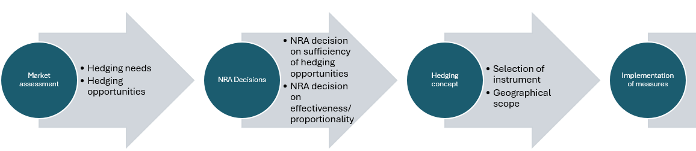
Topic | Hedging analysis
Articles in FCA | Art. 30
Forward Capacity Allocation (FCA 2.0) | Hedging analysis
ENTSO-E advocates hedging interventions only if economically justified.
Current:
Forward Capacity Allocation Regulation (FCA) instructs TSOs to issue LTTRs
(or equivalents), unless sufficient hedging opportunities are available.
Assess hedging needs before obligatory implementation of hedging instruments (such as LTTRs).
Implementation of hedging instrument should reflect established hedging requirements (volume, duration, time to maturity, geographical location & direction).
High Level Process Overview
Scope
Art. 9 Regulation 2019/943 (amended by Regulation 2024/1747): The objective for TSO-issued LTTRs (or equivalent measures) is to enable market participants to hedge price risk.
Subject to the principles of subsidiarity and proportionality, art. 4 TEU.
LTTR: Long-Term Transmission Right

Slide 76

ENTSO-E released Advocacy Papers on 4 critical topics
ENTSO-E (European Network of Transmission System Operators for Electricity) is the association that represents 40 electricity transmission system operators (TSOs) across 36 countries, coordinating the secure and optimal operation of Europe's interconnected power grid and electricity market.
ENTSO-E Papers
Key Messages for FCA 2.0
TSOs call for alternatives to the virtual hub model
[Click here]
  No imposed regional virtual hubs, which are untested solutions not supported by market participants
  Increase auction frequency​ slowly to gain experience & avoid low volumes
  Increase maturities carefully aligned with market liquidity and needs of market participants (up to 2 years)
Collaterals
[Click here]
  Carefully consider collaterals for TSOs - avoiding or minimizing collateral requirements
  Financial validation principle
Volume determination
[Click here]
  Prevent TSOs auctioning beyond their natural hedge (i.e. DA congestion income*)
  Feedback loops considering collateral level and revenue adequacy
  Meet hedging needs of market participants
  Transparent price formation and valuation to tackle undervaluation​
Hedging analysis
[Click here]
  No mandatory FTRs issuance, NRAs to first assess hedging needs and opportunities within each bidding zone, before deciding on measures to support forward markets
  Fundamental analysis (based on production data, hedging ratios…)
  Market equilibrium approach comparing expected net trade flows to hedging volumes
  Market surveys consulting market participants
* DA: Day-Ahead, FTR: Financial Transmission Right, NRA: National Regulatory Authority

Slide 77
Forward Markets
Ljubljana October 2026

Slide 78
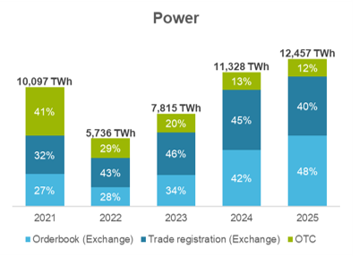
Hedging opportunities in forward power markets
Liquidity is rising
European forward markets have developed positively, providing stability and hedging opportunities across regions. Exchange-based trading and clearing increases in importance , notably since the 2022 energy crisis.
Liquidity is rising naturally and there are no idications this trend will stop.
Challenges to growth foremost relate to:
underlying fundamentals
Grid bottlenecks
Source: Own calculations based on Trayport Commodity Derivatives
Quarterly Reports. “OTC” represents brokered uncleared transactions.

Slide 79
Future outlook
European electricity forward markets have demonstrated their capacity to adapt to shocks, developing the necessary tools for the changing needs of market participants.
Market participants have direct incentives to identify emerging risks and develop commercially viable ways of managing them. Exchanges develop products as needs arise from market participants.
Regulatory uncertainty and miss-guided policy interventions are the greatest risk for forward markets.
E.g. FCA Regulation (centrally imposed virtual hub, role of TSOs in forward markets)
E.g. Poorly designed subsidy schemes
FCA Guideline outlooks (links)
Regional Virtual Trading Hub in CORE
An economically eﬃcient
TSOs involvement in forward markets

Slide 80
Different views on what the market needs
Forward market functioning well?
Liquidity keeps increasing
Liquidity needs to be ensured
Access to hedging in smaller bidding zones?
Longer term liquidity
max Y+2 vs min Y+3 FTR maturity
sufficient demand in Y+3 to avoid undervaluation?
Do FWD markets sufficiently support investments?
FTR volumes
Revenue adequacy
sufficient hedging opportunities
max CZC vs undervaluation
Product design
Support of existing products
Does current LTTR design serve the purpose well?
Design of a sustainable, robust (and direct) support?
Secondary market
Establish dedicated Platform?
via existing forward markets?
FTR undervaluation
Implication from market’s needs?

Slide 81
Discussion on challenges for forward markets
Fragmentation, overlaps, resilience
Identify the gap
Design of support
  OTC/PX futures
  FCA scope/LTTRs
  Do PPAs and CfDs compete or complement futures/forwards
  MIFID & EMIR
  Externally caused market shocks
  Impact of various support schemes
  Does the forward market function sufficiently well without support?
  How to identify and measure the general need for intervention?
  How much support is needed?
  Where is the support needed?
  When do we need to support?
  Robustness – ensuring an enduring support design which can adjust to market developments
  Directness – providing support which directly addresses hedging needs of market participants
  Firmness – suitable heging instrument vs. TSOs’ risk
  Facilitate proxy hedging
  Avoid of market fragmentation
  Costs and challenges of support measures (e.g. collaterals; MIFID obligations; undervaluation …)
+ need for stakeholder involvement (for further discussion under agenda point on conclusions)

Slide 82
Dinner

Slide 83
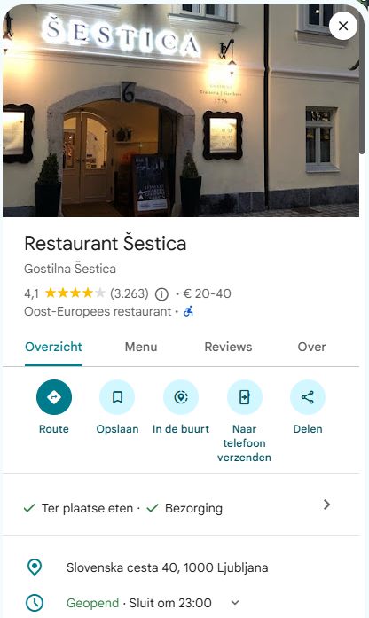
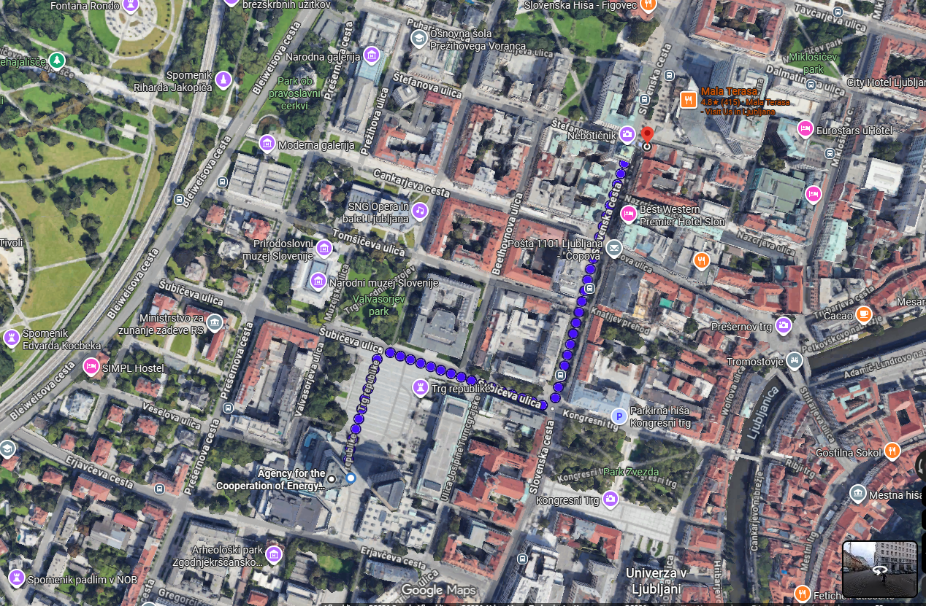
Info on dinner (from 19:30)
[info on dinner]

Slide 84
Agenda – day 2

Slide 85
5. Key Future Challenges for balancing markets

Slide 86
Order of interventions
  EURELECTRIC (3 slides) – 10 minutes
  ENTSO-E (5 slides) – 15 minutes
  ETE (1 slide) – 5 minutes
  Total: 30 minutes

Slide 87
Network codes: key messages
01 CACM GL
02 FCA GL
03 EBGL
Market coupling is a European success story
Diagnosis before prescription
A sound foundation for the future
The core market architecture works.
Priority lies on extending best practices, completing key projects and improving delivery.
Liquidity pools and a broad range of hedging products are available.
Full analysis of root causes of perceived hedging insufficiencies before prescriptive proposals.
Market infrastructure is under completion.
Next step should be to leverage this maximally to build more integrated, more liquid and broadly participated markets.
Make future-proof checks on products, MP requirements and transparency.
Continuous improvement of market coupling systems and fallback arrangements.
Improving TSO coordination action and CZC availability.
LTTR design needs to support MPs’ overall hedging strategy.
Build policy in line with expressed, not presumed, market needs.
Build on efficient balancing platforms for liquid and transparent balancing markets.
Achieve a more seamless market where BSPs/BRPs compete on the same footing.

Slide 88

What are the key challenges in balancing markets?
Balancing
Build on a substantial delivery agenda to support safe, fair and integrated balancing processes
Benefits of balancing market integration are not fully exploited: in the beginning of 2026, 7 TSOs had not yet joined the PICASSO platform, whereas 12 TSOs were missing from the MARI platform.
Late accessions and disconnections harm trust in balancing markets and slow down liquidity growth.
Accession debates also reveal the complexity and operational impacts of these projects.
Market maturity builds over time.
Balancing markets lack transparency: publication of market inputs and outputs on balancing energy platforms is not harmonised and incomplete, or lacking reliability. Imbalance prices are published too late for MPs to properly support the system.
Lack of transparency on balancing market outcomes and national balancing markets harms balancing market integration.
Continued reliance on specific products raises questions about interactions with PICASSO/MARI.
Fragmentation of BSP and BRP rules: more efforts are needed to achieve a level playing field on balancing markets.
Access and operating conditions for BSPs differ significantly, raising questions about the equal quality of standard products exchanged on PICASSO and MARI.
Different approaches to imbalance settlement result in different incentives for BRPs on the coupled markets.
Disruptive policy proposals cause uncertainty: electricity markets are undergoing a major transition, and the current list of products might become unfit for future system needs.
TSOs should assess whether current markets and products are sufficient to balance the system and attract sufficient volumes.
Existing target model around technology-neutral balancing products and self-dispatch supports balancing market efficiency.
Calls for co-optimisation or a 5’ ISP are premature and prompting a strong call for transparency and MPs' involvement.

Slide 89
Proposals for efficient balancing markets
Balancing
Benefits of balancing market integration are not fully exploited
Incentives and governance mechanisms for TSOs to join in ambitious yet reasonable timelines.
Make future-proof checks on products: standard product design should be genuinely technology neutral.
Identical services used by TSOs should follow the same market-based procurement rules (e.g. FCR).
Balancing markets lack transparency
Ensure harmonised and centralised publication of all market inputs and outputs on the ENTSOE TP.
Publish standardised information about national balancing market functioning and access conditions
Publish imbalance prices in near real-time.
Improved transparency on reliance on specific products in each bidding zone and possible impacts on the level playing field and the participation to standard products.
Fragmented BSP and BRP rules
Conduct comparative assessment of pre-qualification and ex-post verification: assessment should result in harmonised principles based on best practice.
Ensure fair and equal treatment of BSPs regardless of location, size, or technology.
Move towards harmonised IT infrastructure: TSO communication standards, etc.
Increase harmonisation ambition of imbalance price principles (single price, based on a WA of BE activation prices).
Disruptive policy proposals cause uncertainty
Assess product offer: standard product catalogue needs to meet both current and future system needs. Long-term evolutions take time to unfold, preparation should start now.
Avoid co-optimisation until its added value, operational feasibility and compatibility with the target model have been demonstrated under real market conditions. Market-based exchange of balancing capacity is easier to implement.
Keep the current ISP: a 5’ ISP would require deep changes to MP processes, with costs likely outweighing benefits
Looking ahead: how to future-proof balancing markets
Improvements to capacity calculation: with lack of cross-zonal capacity an issue particularly in small BZs, improvements should be considered.

Slide 90
Future of balancing: TSOs future challenges and priorities
8-9 October 2026, MESC

Slide 91
EB Regulation 1.0 delivered major value and largely completed balancing market integration
EU balancing energy platforms (PICASSO, MARI) delivered strong welfare gains: ~€1.2bn economic surplus in 2025
Harmonisation of standard balancing products
Harmonisation of 15-minute Imbalance Settlement Period, for majority of countries
Harmonised Cross-Zonal Capacity Allocation (development in progress)
Market-based procurement of balancing energy and balancing capacity
Imbalance Settlement Harmonisation methodology implementation
EB Reg. 1.0 implementations
With All TSOs joining PICASSO & MARI, only residual efficiency gains from further integration can be expected

Slide 92
2035/2040 system outlook
System evolution
More and closer to real time congestions due to more electrification, decentralised RES and flexibility
More cross‑border flows due to more electrification, RES (in particular, offshore wind) and further flow-based implementation
Harder to maintain frequency stability due to higher and faster variations in productions and forecast uncertainty. The potential lack of inertia is still under investigation.
Stability and observability challenges due to growing role of RES, batteries and power electronics
Lack of sensitivity to the market price signals – imbalances will increasingly depend on local, decentral generation and/or consumption that is not always driven by market price signals.
Developments in the electricity supply system remain challenging to predict.

Slide 93
Emerging challenges for TSOs in system balancing (for next 10-15 years)
Unlock decentral flexibility for balancing and congestion management
RES keep increasing resulting in less centralized, less controllable production
Electrification and large power flows result in more congestions at all voltage levels
TSOs will need new sources of (and potentially more) flexibility, for balancing and local services, due to changes in the electricity production mix, pushing more frequently the fossil fuel energy sources out of the market, therefore not available for balancing (or at the very high price)
TSOs and DSOs will need to collaborate at the local level to accelerate the unlocking of flexibility in medium and low voltage grids, as foreseen in NC DR framework
1
Manage extreme balancing events​
Increasing RES may result in very large forecast errors (cf. high PV infeed, storm risk for offshore wind,…)​
Dimensioning rules based on historical imbalances and the reference incident may not be sufficient to capture the volatility introduced by RES as forecast errors might exceed these imbalances
Regional synergies in dimensioning may help but will not be sufficient​ (e.g. in case of correlated imbalances across countries, or unavailable cross-border capacity)
Extreme events cannot be managed efficiently by standardised, centralised products only. TSOs must retain the ability to deploy exceptional, context‑specific measures
2
Get the right flexibility in the right product​
Fragmentation of liquidity is already a reality, and price signals may be inefficient to attract the right flexibility in the right product
Fragmentation risks to increase with procurement of congestion products by TSOs and DSOs​
TSOs and DSOs will need to collaborate to ensure an efficient pooling and activation of flexibility, as foreseen in NC DR framework
3

Slide 94
Emerging challenges for TSOs in system balancing (for next 10-15 years)
4
Increasing efficiency of balancing capacity procurement with the objective to reduce balancing costs
    Possible solutions identified (non-exhaustive list): extend balancing capacity cooperation where relevant, elastic demand, price cap/range, increase liquidity in BC market by further unlocking flexibility in certain markets.
5
Liquidity in balancing platforms should be improved to cut costs by addressing technical and product barriers for BSPs, while avoiding indiscriminate lowering of qualification standards and preserving clear, robust requirements, to maintain a good level of system security.
Based on these challenges, the current EB Regulation seems appropriate, and focus should be on NC DR implementation

Slide 95
Key messages
1
Market integration delivered major value – and will be complete with all TSOs joining PICASSO & MARI.
2
Main future challenges are local, decentral and operational. NCDR implementation will be a priority for the next decade
3
TSOs remain accountable for security and must retain the corresponding tools, considering local public acceptability. Local exceptional measures will remain needed
4
Flexibility must be coordinated locally, not commanded centrally. Role of RCC should remain primarily advisory

Slide 96
8-9 October 2026
ISKLJUČIVO PRIMATELJU
Market Stakeholder Committee
Ljubljana

Slide 97
Balancing market
ISKLJUČIVO PRIMATELJU
Aim: give more space for the market to act, increase transparency and harmonisation
Progressively align TSO balancing philosophies, preferably towards a more reactive approach where BRPs are allowed to balance their portfolios before TSOs intervene.
Increase harmonisation of communication infrastructure towards TSOs, prequalification and flexibility of scheduling deadlines
Promote transparency from TSO in real-time balancing market status to provide a better price signal
PICASSO/MARI integration should be complemented by monitoring of national implementation differences. The objective should be operational convergence, not platform connection alone.

Slide 98


Summary of the main stakeholder’s views on the future challenges for balancing markets
Market Policy
Market Participation
Balancing Operation
Incomplete market integration
Fragmented BSP and BRP rules
Forecast error and managing extreme balancing events​ & congestion
Lack of harmonisation and level playing field
Lack/fragmentation of liquidity
Lack of cross-zonal capacity
Disruptive policy proposals and uncertainty
Insufficient market transparency and publication of data
Insufficient regional cooperation and high procurement cost
Need for future-proof and technology-neutral product offering
Non-aligned TSO balancing philosophies

Slide 99
Stakeholders and ACER main future challenges for balancing markets
Additional Potential Challenges Identified by ACER
Transparent, inclusive & level-playing filed balancing markets
Further integration of balancing markets
Reliable balancing markets
Balancing market signals
Evolving short-term markets
  Challenges for close to real-time data publication & access
  Sufficiently liquid and accessible to all technologies
  Balancing operation & rules ensuring level playing field market for European balancing market participants
  Challenges for availability of cross-zonal capacity to enable sufficient access to cheaper cross-border balancing resources
  Regional cooperation for cross-border exchange and reducing procurement costs
  Challenges for ensuring that balancing activation including RES and DERs, does not create or aggravate real-time congestion
  Balancing market signals supporting efficient balancing and congestion management
  Challenges for providing appropriate incentives for market participants to contribute to EU-wide system balance, following introduction of EU balancing platforms
  BRPs responses and creation of oscillations or additional imbalances
  Challenges for close-to-real-time balancing markets and processes as intraday gate closure times move closer to real-time
  Shorter lead times and secure balancing markets & system operation

Slide 100
6. Key Future challenges in Demand Response & Congestion Management
Stakeholder interventions (1h40)
ACER contribution & discussion (0.5h)

Slide 101
Order of interventions
  EURELECTRIC (2 slides) – 5 minute -
  IFIEC (2 slides) – 5 minutes – Michael van Bossuyt
  DR4EU – 10 min
  SmartEN – 15 min (max) – Guro Grotterud
  ENTSO-E 1. on DR – 5 minutes and 2 on CM – 10 minutes – Javier Barantes (online)
  [coffee break around 11:00]
  EUDSO-entity – 15min – Torsten Knopp
  ETE (new) – 5 min - ?
  Solar Power Europe (new) – 10 min – Laurent Schmitt (online)
  Europex (new) – 10 min - ?
  Total 1h30min

Slide 102
What are the key challenges in demand response and congestion management?
DR & CM
A market-based framework for flexibility is under way, but uncertainties persist
EU framework for flexibility lags behind: competitive procurement of flexibility is key to address higher need for congestion management and voltage control services, but regulatory uncertainty remains pending NCDR adoption.
Discriminatory and asset-specific access conditions to flexibility markets, as well as fit for purpose prequalification and equivalences need to be addressed by NCDR.
Unclear legal implications for MPs offering capacity on flex markets and bidding on wholesale markets.
Responsibility for imbalances and other costs between independent aggregators and suppliers are not fully reflected in aggregation models.
Interactions between CM and wholesale markets: bid forwarding and bid filtering raise questions of fairness and market efficiency.
Products offered on balancing energy markets and local flexibility markets may have a different value for MPs.
Treatment of balancing bids used or withheld by TSOs for congestion management purposes distorts balancing price formation.
The interoperability concept under NCDR potentially undermines market efficiency (portfolio bidding in spot markets) and the clarity of market roles.
Lack of coordination between grid operators: congestion and lack of visibility about balancing and flexibility activations at different grid levels are prompting grid operators to restrict balancing service provision.
NCDR needs to improve visibility of DSOs about balancing services causing grid congestion, whereas TSOs should be aware of flexibility committed at DSO level.
TSOs are not coordinating enough to mitigate the impact of higher redispatch needs.

Slide 103
Proposals for efficient management of flexibility
DR & CM
EU framework for flexibility lags behind
Adopt the NCDR: comitology on the NC has been delayed, with no transparency on the proposal since the November 2025 consultation.
Reduce market access barriers: simplified and non-discriminatory access to flexibility markets across EU member states.
Lack of coordination between grid operators
Strengthen TSO-DSO communication for system security, congestion management & operational planning.
Implement RDCT coordination: it will improve congestion management, reducing costs and improving access to cross-zonal capacity.
Interactions between CM and wholesale markets
Remunerate balancing bids withheld or used for CM reasons.
Prioritise locational investment signals: locational elements should be limited to investment signals (auction criteria, connection charges) to preserve a fair competitive environment for existing assets.
Clarify the articulation between local flexibility markets and wholesale markets, and preserve portfolio bidding in DA and ID.

Slide 104
IFIEC EUROPE
MESC Strategic Conference
8-9/10/2026 - Ljubljana

Slide 105
3. Key Future challenges in Demand Response & congestion management
Development of demand response, including the NC DR
  Enable demand response, standardize solutions (especially for low voltage applications) insofar leading to benefits but also do not retrograde compared to the status quo
  The goal is to allow all flexibility to find its way to the systems ➔ Explicit or implicit
  Remove all barriers as priority: Smart meters, dynamic pricing including correct price signals from tariffs, regulatory frameworks, work from the side of system operators, suppliers, BRPs, FSPs, … ➔ No regret measures!
105

Slide 106
3. Key Future challenges in Demand Response & congestion management
Congestion management
  Infrastructure lag, locational mismatches, heavy reliance on expensive redispatch actions
  FBMC forces the day-ahead market algorithm to recognize the correct/relevant Critical Network Elements (CNECs)
  Management of physical grid leads to redispatching ➔ System costs increase, and are borne by grid users who are already struggling
  Polluter pays principle, in particular big zones with internal congestion? ➔ Freeriding on grids does not lead to an optimal use, pre-allocated capacities lead to unfair and unnecessary congestion management, which can be very costly ➔ Polluters should pay for the costs they cause for themselves and for others
106

Slide 107
Demand Response & Congestion Management
Best ways to involve stakeholders
Elements shared at the
MESC Strategic Conference
9th October 2026

Slide 108
Involving consumers at scale: EU (wholesale) market based approach
Providing volunteering consumers with automation and operation of their DSR
Aggregators to invest on the basis of benefits of DR to all consumers via wholesale markets, alongside generation – no discrimination (EMD art.17-1&2)
Explicit aggregated DSR activated upon request, accurate and reliable, same responsibilities as generators, i.e. to deliver as so (EMR, art. 5, recital 15)
Obligations set forth at EU level: do not twist balancing responsibilities nor create a barrier for DSR to participate in all markets
10–12×
DSR benefits vs costs in 2030
French failure
€30 – 100/year
per European consumer
Source: Compass Lexecon, shared at DR4EU workshop March 2026

Slide 109
DSR to facilitate congestion management
Build confidence
Beyond EU general obligation to consider DSR as a complement to grid reinforcement
Beyond local market flex based mainly on short term opportunities
Grid management, for instance: DI to avoid curtailment of RES
Demand increase increases prices for all: i.e. cost
… but benefits may come from reduced curtailment costs
Remuneration of DI should take account of those benefits
Flex obligations, e.g. for (priority) connection of data centres
Let them secure contracts with aggregators
…to deliver DSR available when needed
Contractual framework
Reliable way to secure the system => need for long term commitments
Locate flex investment in the relevant area
Combine capacity payment for flex available when needed + activation

Slide 110
Demand response and congestion management
Main challenges
MESC Conference, Ljubljana, 8-9 October 2026
Guro Grøtterud
guro.grotterud@nodesmarket.com

Slide 111
What can DSF do for the power system?
Source: DNV/smartEn – Demand side flexibility, quantification of benefits in 2030 for EU-27

Slide 112
Optimised use of DR throughout the power system
Implement and optimise the use of congestion management markets
Maximise market participation/ available liquidity
  Remove unnecessary barriers to participation
  Ensure stackability across different markets
  Ensure business models and services may be deployed across Member States

Slide 113
Optimise SO’s use of CM markets
Several tools on SOs’ hands to avoid grids becoming the bottleneck of the European power system
  Investment
  Dynamic/cost reflective grid tariffs
  Flexible connection agreements
  Market based congestion management.
Different timeframes, different situations require different solutions or combination of solutions.
If the incentives are not right, the preferred solutions will not be
  FCAs as “free flexibility” for SOs
  CAPEX/OPEX bias
Need to understand
  what are the best ways to combine mechanisms at the hands of SOs
  How to enable “maintenance” of market liquidity
  how to incentivise SOs to aim at overall optimised social welfare
    In their use of different mechanisms
    In their coordinated use of flexibility across grids and timeframes

Slide 114
Remove barriers to participation
Delivery of explicit demand response depends on:
  Baselines (what would have happened if explicit DR was not activated)
  Measurements (main meter and/or DMD)
Both buyers (SOs) and sellers (service providers, independent aggregators) benefit from high quality, trustworthy baselines and measurements. It’s the service providers who have the expertise.
→ Support a range of objective baseline methodologies, so that errors can be minimised.
→ Nominative baselines are the only solution for highly-variable resources, but their use must be monitored, with enforcement powers if they are abused.
→ EMD only forces SOs to accept DMDs where there’s no smart meter, or it doesn’t provide adequate data. DMDs reduce measurement and baseline errors in other cases, so should be allowed. Monitoring and enforcement powers are needed to avoid abuse of compensation effects.

Slide 115
Stackability across markets
DSO markets are structurally scarce
If they need to compete with other markets for participation, only assets or services providers not qualified for other markets will participate, aggravating the scarcity.
Coordination of market timelines and products, bid sharing or TSO-DSO cooperation are possible measures, but may require cooperation of several entities.
→ Need to further identify best practices and, if necessary, align requirements with these.

Slide 116
Access markets across Member States
Markets for local congestion management are still at a nascent stage.
Products, interfaces and use are not harmonised in most Member States.
Harmonisation and standardisation would facilitate
  Participation across borders
  Setup of markets by further SOs
Harmonised products on European level – however leaving space for continued innovation.
Interoperability and standardised interfaces would facilitate market participation and sharing of necessary data.

Slide 117
Enabling Distributed Flexibility: Key Regulatory and Technical Needs (1)
1. Legal Basis and Roles
The NC DR must stay aligned with the EU’s legal framework while respecting national differences in energy systems. We recommend maintaining flexibility for Member States to define responsibilities in line with their national frameworks.
2. Harmonisation and National Implementation
While harmonisation is important, rigid and short EU deadlines may disrupt national implementation and increase costs. ENTSO-E proposes more phased approach for harmonization, based on evidence from NC DR Implementation monitoring.
3. Reliability and Security
Flexibility must not compromise reliability. Proposals such as reducing minimum balancing bid size could add risk and complexity, despite small assets already having access to markets through aggregation.
4. Standardised Data Exchange
ENTSO-E supports a pragmatic, standards-based approach to data exchange, relying on existing ETSI-CEN-CENELEC standards wherever possible. Together with the EU DSO Entity, ENTSO-E should publish and maintain a list of preferred European standards, while ensuring the list reflects market maturity, innovation needs, implementation costs, and evolving standardisation developments.

Slide 118


Enabling Distributed Flexibility: Key Regulatory and Technical Needs (2)
5. Connection Requirements
ENTSO-E would also highlight that the harmonisation of connection requirements is an important enabler for distributed flexibility resources. The Requirements for Generators and Demand Connection Network Codes can support a more consistent framework for the connection and operation of DER assets. In addition, ENTSO-E recommends that additional and tailor-made connection requirements for data centres should be considered.
6. Cybersecurity risk
ENTSO-E stresses that the rapid growth of small-scale connected assets must be accompanied by stronger cybersecurity requirements. Existing distributed resources may have uneven cybersecurity standards and could create system-level vulnerabilities if exposed to coordinated attacks. Going forward, cybersecurity-by-design should be embedded in the next wave of small-scale assets, supported by clear standards, certification and monitoring.
7. Observability & controllability:
ENTSO-E advocates for unlocking the full flexibility potential of RES, particularly during periods of high generation and low demand. This requires improving the observability and controllability of RES assets by:
The rollout of smart and granular metering systems to make assets observable;
Standardised control interfaces and data exchange between plant operators, Balance Responsible Parties, and system operators;
Financial and regulatory frameworks that encourage RES to adjust generation dynamically and participate in balancing and system services.

Slide 119
ENTSO-E Paper on Market Design Options for Congestion Management
MESC | 9 October 2026

Slide 120
ENTSO-E Paper on Market Design Options for Congestion Management Study approach
Root causes
Slow and insufficient grid development
Increasing gap between market outcomes & physics
Key Challenges
Increasing congestions and associated costs
Integration of new renewables capacities and
flexibilities
Shorter time to deal with higher variability and
uncertainty of congestion patterns
Risk of insufficient grid-serving (including balancing) system flexibility
Policy and market Participant dependencies
Complex Cross-Border Coordination
Effectiveness of relying on remedial actions to
implement the minimum 70 % rule
Find the publication on ENTSO-E website: ENTSO-E Position Paper on Market Design Options

Slide 121
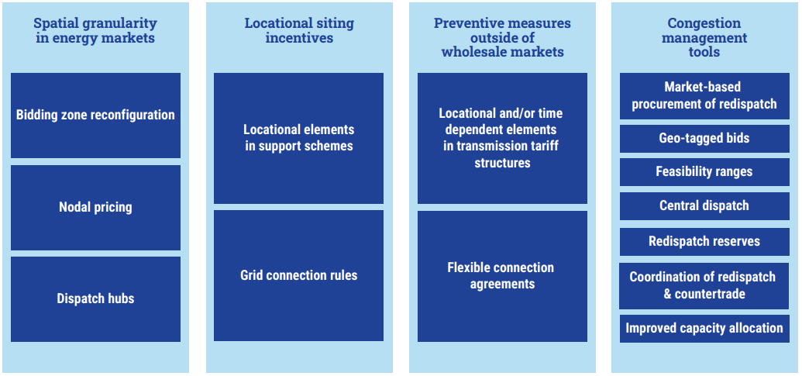
ENTSO-E Paper on Market Design Options for Congestion Management Overview of market design solutions
Locational elements in Capacity Mechanisms, RES & Flex Support Schemes
Find the publication on ENTSO-E website: ENTSO-E Position Paper on Market Design Options

Slide 122
ENTSO-E Paper on Market Design Options for Congestion Management Evaluation criteria for market design solutions
Evaluation Criterion (EC) | What it captures
EC1 – Dispatch and congestion management efficiency | Costs and volumes of redispatch/countertrade; balancing impacts; socio-economic effects; efficient use of transmission capacity; quality of price signals for flexibility.
EC2 – Operational security | Effectiveness in relieving congestion; robustness under uncertainty; remaining complexity for operations; impact on need for corrective measures after markets.
EC3 – Investment efficiency (long-term power system impacts) | Long-term siting and co-location signals; impacts on grid development needs; effects on WACC/investment risk; interaction with support schemes.
EC4 – Market impacts | Impacts on liquidity and transaction costs across DA/ID/BAL/forwards; affordability and distributional effects; harmonisation vs national flexibility; cross-border effects.
EC5 – Transition & implementation challenges | Legal, technical and organisational efforts; implementation time & costs for TSOs and market parties; acceptability; robustness to future system evolution.

Slide 123
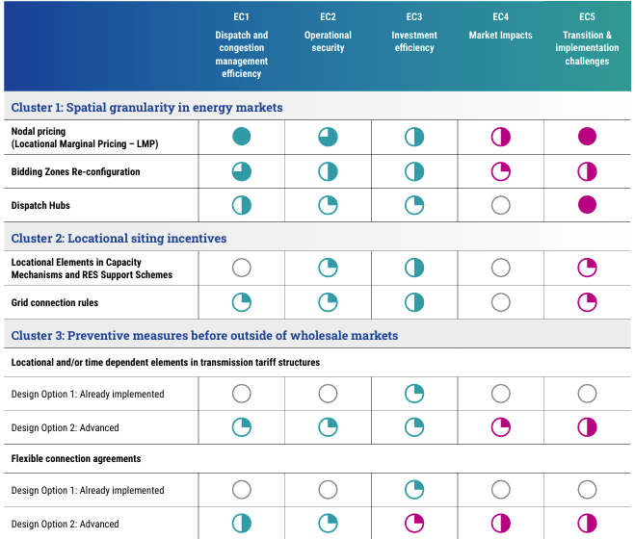
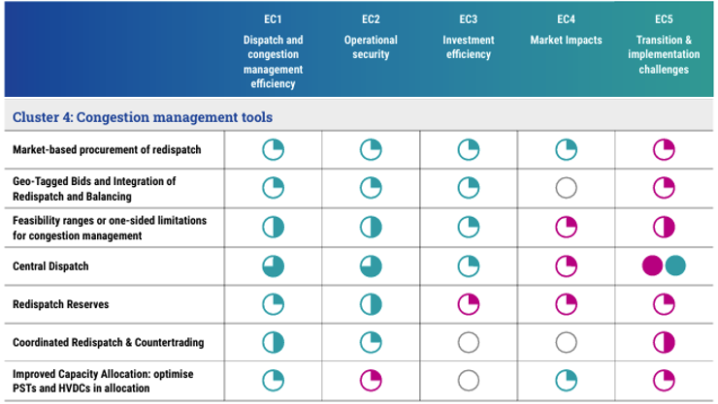
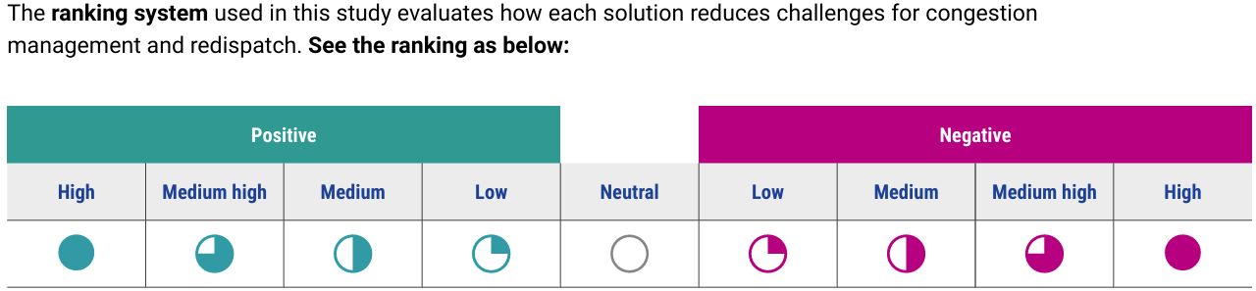
ENTSO-E Paper on Market Design Options for Congestion Management Overview of evaluations

Slide 124
ENTSO-E Paper on Market Design Options for Congestion Management Possible system-specific policy pathways
1. Systems with predictable Internal
Congestion addressed via finer spatial granularity
2. Highly Interconnected Congestion Systems
3. Limited-Interconnection Systems with Variable Congestion
For each archetype, a set of possible solutions is presented to address the underlying congestion challenges.
Internal Bidding Zones and Self-dispatch
New Internal Bidding Zones
Preventive congestion management before intraday gate closure in self-dispatch framework
Internal Bidding Zones and Central Dispatch
Without Bidding Zone Reconfiguration
Preventive congestion management before intraday gate closure in central dispatch framework
From Internal Bidding Zones to Nodal Pricing
Preventive congestion management after Intraday gate closure combined with proactive investment signals

Slide 125
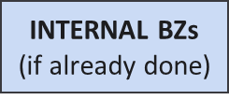
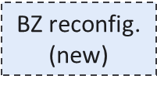
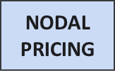
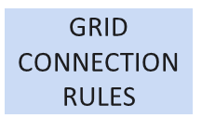
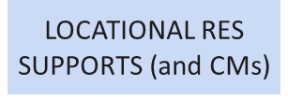
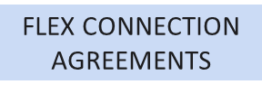
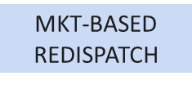
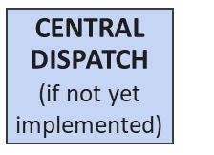
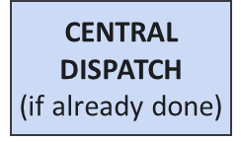
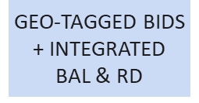
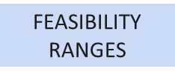
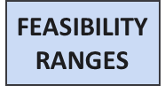
ENTSO-E Paper on Market Design Options for Congestion Management Archetype 1: Systems with predictable Internal Congestion addressed via finer spatial granularity
Systems in this archetype experience long-term stable & predictable congestions, mainly within their own grid. These congestions are primarily addressed through finer spatial granularity such as internal Bidding Zones
Possible Policy pathways for Archetype 1
Internal BZs + Self-dispatch
Internal BZs + Central Dispatch
From Internal BZs to Nodal Pricing
Spatial granularity
Locational siting incentives
Preventive measures outside wholesale markets
Congestion mgmt.
tools
Short-term
Mid-term
Long-term
Short-term
Mid-term
Long-term
Short-term
Mid-term
Long-term

Slide 126
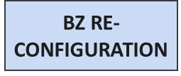
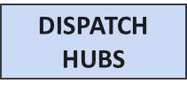
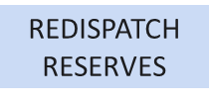
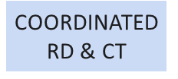
ENTSO-E Paper on Market Design Options for Congestion Management Archetype 2: Highly Interconnected Congestion Systems
These highly interconnected systems are significantly impacted by XZ interactions, such as loop flows. Congestions are generally long term but shaped by both domestic & neighbouring grid conditions, making coordination across BZ essential. Increasing variability & uncertainty leads to more volatile short-term congestion, requiring more frequent, near real-time interventions.
Possible Policy pathways for Archetype 2
New Internal Bidding Zones
Without BZ Reconfiguration
From Internal BZs to Nodal Pricing
Spatial granularity
Locational siting incentives
Preventive measures outside wholesale mkts
Congestion mgmt.
tools
Short-term
Mid-term
Long-term
Short-term
Mid-term
Long-term
Short-term
Mid-term
Long-term

Slide 127
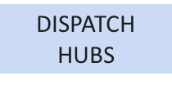

ENTSO-E Paper on Market Design Options for Congestion Management Archetype 3: Limited-Interconnection Systems with variable congestions
In these systems with limited interconnection capacity, congestions are mostly internal and variable rather than structurally stable. Temporary congestions in this archetype do not require modifications in terms of spatial resolution of energy markets. Instead, congestion management often relies on operational tools and preventive approaches, supported by targeted investment signals.
Possible Policy pathways for Archetype 3
Preventive Congestion Mgmt before ID GCT + self-dispatch
Preventive Congestion Mgmt before ID GCT + central dispatch
Preventive Congestion Mgmt after ID GCT + proactive investment signals
Spatial granularity
Locational siting incentives
Preventive measures outside wholesale mkts
Congestion mgmt.
tools
Short-term
Mid-term
Long-term
Short-term
Mid-term
Long-term
Short-term
Mid-term
Long-term

Slide 128
ENTSO-E Paper on Market Design Options for Congestion Management Policy Recommendations – 1/3
General
To ensure system security in a cost-efficient manner, policy makers should enable solutions to bridge the gap between markets and physics. Such solutions should aim at maximising trading opportunities for a truly integrated internal electricity market , but respect technical and operational limits as a priority. One current limitation to aligning physics & markets is the use of virtual margins in capacity calculation processes, as these carry significant collateral consequences for system operations. In current regulation virtual margins are a key feature of the min.70% framework. The principle behind the 70% framework (achieve market integration & avoid undue discrimination between internal and cross-zonal exchanges), remains fundamental. However, alternative ways of aligning market and should be explored.
Spatial granularity in energy markets
Recognise increased spatial granularity as a structurally effective long-term solution from congestion minimisation perspective, while acknowledging market impact together with implementation challenges and political implications. Consider context and region-specific pathways (e.g. bidding zone reconfiguration and/or dispatch hubs or potentially even nodal pricing, where proven to be feasible and efficient) depending on the significance and variability of the structural congestions, while ensuring internal electricity market efficiency. Ensure that any increase in spatial granularity addresses market parties’ needs of liquidity, risk hedging and investment certainty. Balance the need for periodic assessment/update of spatial granularity with predictability and stability for market participants (i.e. avoid too frequent or unpredictable reconfiguration).

Slide 129
ENTSO-E Paper on Market Design Options for Congestion Management Policy Recommendations – 2/3
Locational siting incentives
Where appropriate, integrate locational elements into capacity mechanisms, RES support schemes and flexibility support schemes where such schemes already exist. Consider using locational criteria in grid connections rules to steer new investments toward grid-supportive locations and to ensure that investment decisions reflect part of the congestion and redispatch costs they may impose on the system. Acknowledge that locational incentives are complementary instruments with primarily long-term effects and should not be expected to solve short-term congestion challenges. Ensure transparency, non-discrimination, cost-based design, and consistency with EU state aid and internal market principles.
Preventive measures outside of market clearing
Promote preventive measures that reduce redispatch volumes and uncertainty, while carefully balancing efficiency gains against forecast errors and implementation complexity. Consider flexible connection agreements as a tool in congested areas, with design choices (scope, timing, compensation, voluntariness) taking into account regulatory framework , system needs and market implications. In particular, the use of voluntary flexible connection agreements in congested areas should be expanded building on existing national experiences. Transmission and distribution tariffs can provide stable and transparent locational or time-dependent dispatch signals. More dynamic signals with locational elements should be carefully analysed to evaluate potential benefits against disadvantages. Ensure strong TSO–DSO coordination and clear communication to market participants to limit operational and behavioural risks.

Slide 130
ENTSO-E Paper on Market Design Options for Congestion Management Policy Recommendations – 3/3
Congestion management tools
Ensure the continued availability of timely, location-specific congestion management and redispatch resources to safeguard operational security under increasing uncertainty. Prefer market-based and integrated solutions (e.g. market-based redispatch, integration of balancing and redispatch) where sufficient liquidity and competition between service providers can be ensured, while recognising their limits depending on locational congestion patterns and carefully assessing overall market impacts. Apply intervention tools (e.g. redispatch reserves) only as targeted or temporary measures, not as permanent substitutes for less costly structural solutions. In systems where it’s already applied, leverage benefits of central dispatch approaches to balance market efficiency with the need to keep the system secure while optimising congestion management costs. Similarly, systems that apply or want to make use of the feasibility ranges concept should find an appropriate balance in their application. Continue improving cross-border coordination of redispatch and countertrade, including through regional operational frameworks, to minimise total system costs.

Slide 131
ENTSO-E Paper on Market Design Options for Congestion Management Concluding Messages
An energy transition at the lowest cost for consumers requires not only massive & timely grid investments but also better use of existing grids. Both operational evolutions (DLR, forecasts, PSTs, etc) and Market design solutions better reflecting physics are key to achieve this. Focus of our paper is the latter.
Different solutions exist: spatial granularity, locational siting incentives, preventive measures, Capacity Mechanism tools. As general principle, either the market design (and market participants) helps minimising or addressing congestions, or TSOs will need more tools (or preventive measures) for congestion management.
No one-size fits all, as countries have different grid topologies/generation mix/demand and measures have different trade-offs which policy makers should be allowed to choose [as they may favour certain national policy objectives or group of stakeholders over others]
However, it's essential to identify coherent policy pathways combining solutions that can work efficiently together, while also preserving overall IEM efficiency.
Many of the measures identified can be already implemented at national level, while others may require legislative adjustments [e.g. 70%]

Slide 132
Coffee break
Until 11:15

Slide 133


DSO ENTITY
Key challenges for demand response & congestion management:
The best way to involve stakeholders
Torsten Knop

Slide 134
DSOs as Market Facilitators for Local Services: Local by Nature, European by Impact
Local ≠ System-Wide
Local grid challenges differ fundamentally from system-wide: highly locational and time-specific
Distribution-level constraints
Optimized combination of tools, considering the specific requirements of different network types.
National Terms & Conditions
National Terms & Conditions are the important for implementing the NCDR
Markets for local services
Tailoring to specificities and capabilities of SO including involvement and commitment of all stakeholders
Local flexibility markets
FCA
Rules-based
Implicit Flexibility
Allows all grid users to provide flexibility on a competitive and non-discriminatory way
Provide new and existing customers with an option where the full capacity is not available
Complementary to other mechanisms rules-based approaches can provide solutions
Incentivize a certain customer behavior and unlock the potential of implicit flexibility

Slide 135
DSO Entity key recommendations
Commitment by NRA
for swift approval
R2: Define and publish a transparent roadmap to implement local markets
R10: Establish efficient TSO–DSO and DSO–DSO coordination through jointly defined proposals
R11: Develop proportional, standardised and interoperable data, ICT and (near-)real-time communication requirements for local flexibility services
R9: Ensure physical delivery of flexibility to the grid
R8: Establish Flexibility Information System (FIS) modules by building on existing infrastructures
R5: Secure the flexibility value from end-to-end
R1: Start now and embrace the opportunities and challenges that come with the use of flexibility services
R3: Engage Stakeholders in the implementation process and jointly manage change
R6: Procure local services and operate markets where efficient
R4: Promote opportunities for customers to become flexible to develop the needed liquidity for local markets
R7: Develop tailored (yet standardised) local flexibility products, markets rules and processes
135

Slide 136

DSO must engage early and align with relevant stakeholders
Structured and transparent implementation roadmap:
    All parties can work collaboratively
    Closing identified gaps, implementing and scaling up flexibility while making best use of test and learn
In addition, DSO should provide service providers short- and long-term visibility about opportunities in the local market.
Acknowledge that things will not be perfect immediately:
    Rules, technical and economic aspects
Accept to overcome these difficulties by:
    Common understanding of the impact of the gaps, shared trust and joint objectives
Require a commitment from NRA to swiftly approve regulatory changes when gaps are identified.

Slide 137
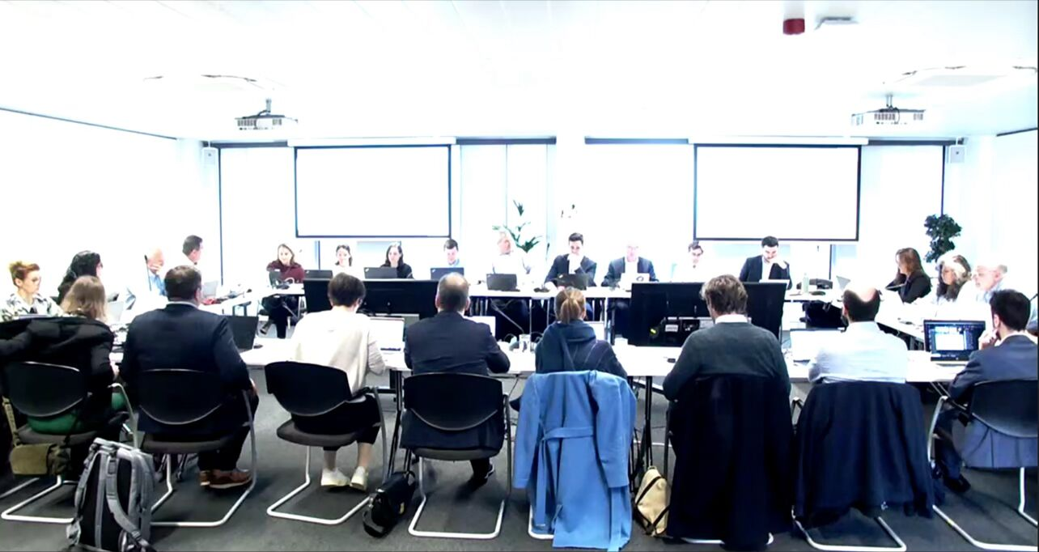
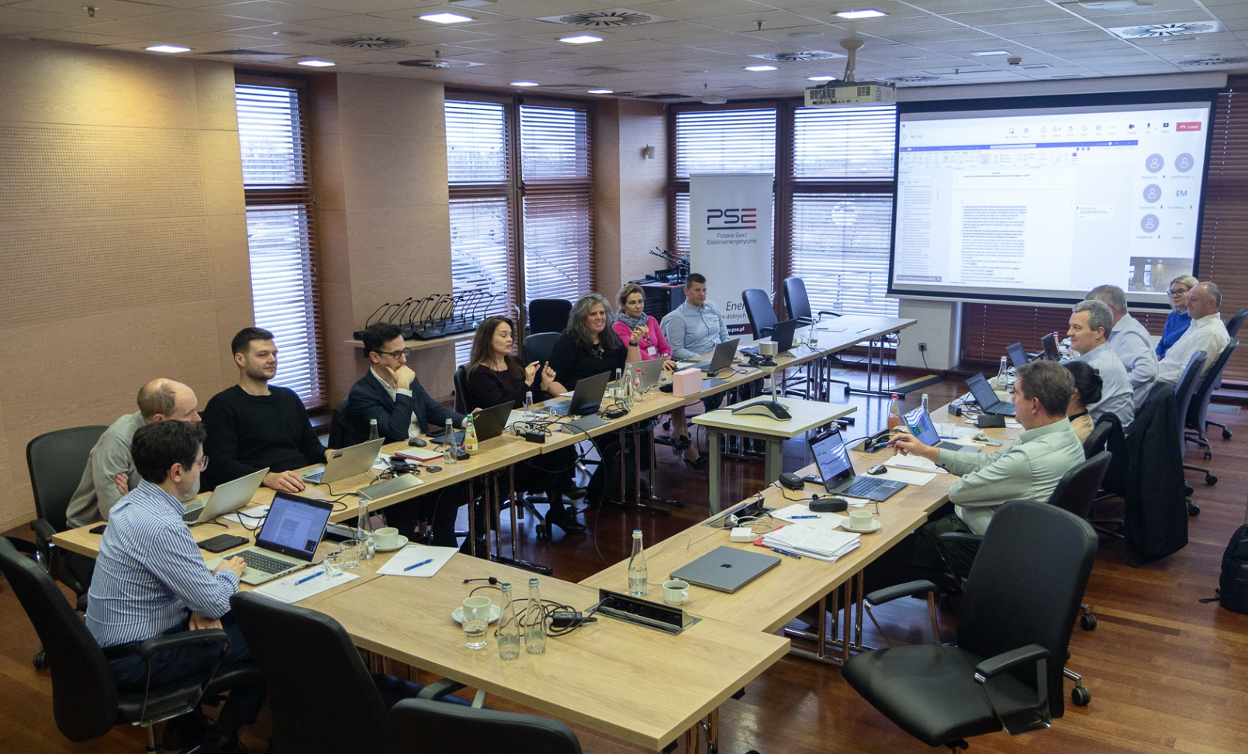













Stakeholder engagement – Drafting Committee and beyond
DSO Entity and ENTSO-E convened a Drafting Committee to support the NCDR development process.
The Drafting Committee members:
  Received information in a timely and transparent way about the Development Team.
  Identified focus topics for in-depth discussion in the Drafting Committee.
  Had access to the NCDR draft released by the Development Team every month.
However, stakeholders’ engagement was broader by:
  Repeated consultations on relevant drafts of the Network Code
  Multiple ad hoc engagement with stakeholders on specific topics.
400+ meetings involving over 200+ experts
Stakeholders encourage similar process
in the future
137

Slide 138
8-9 October 2026
ISKLJUČIVO PRIMATELJU
Market Stakeholder Committee
Ljubljana

Slide 139
Demand response, flexibility and congestion
ISKLJUČIVO PRIMATELJU
management
Aim: allow the wholesale market to play its role, and keep interactions (or separations) clear
Greater transparency regarding TSO´s redispatch actions in continuous electricity trading
Improve TSO–TSO and TSO–DSO coordination.
Develop technology-neutral, competitive procurement of congestion-management flexibility.
Enable cross-zonal participation where technically and legally appropriate.
Improve market-based redispatch, constraint and capacity-calculation transparency.
Improved locational signals in support schemes, capacity remuneration mechanisms and tariffs.

Slide 140

Demand Response Network Code
SolarPower Europe
Strategic Challenges to be adressed
9 October 2026

Slide 141
Key Challenges and NCDR detailed implementation priorities
Use of DMDs for all mass-produced DERs (Article 19, 20 and 21)
Harmonised CEN CENELEC standards for DR data exchanges (NEW proposed Article 32)
Refine Market based procurement & derogation rules (Article 38 to 41 and 49 to 51)
FCAs framework and Power Control System interfaces (Article 40)
Simplified prequalification of Distributed Energy Resources (Article 29)
Simplify and harmonise data exchange requirements across EU (Article 61)
Stakeholders involvement and Implementation of requirements (Article 15)

Slide 142
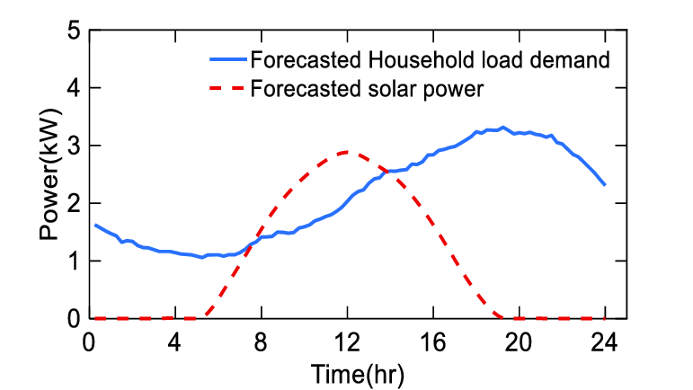
SolarPower Europe distinguishes two types of FCAs
Reduction of injection based on post-market signal (10h – 12h)
Reduction of withdrawal based on post-market signal (19h – 22h)
Regular grid connection agreement
Example with a 5kWp agreement - The generator or the consumer can inject or withdraw as much electricity as needed between 0 and 5 kWp.
Static flexible grid connection agreement
Definition: a contract including a static, unchanged overtime maximum limit to injection and/or withdrawal of electricity
Example with a 2.5 kWp FCA:
In the example, the contract is capped at 2.5 kWp – no injection above or withdrawal above 2.5 kWp.
The consumer can optimize their power generation by adding a battery or an energy management system monitoring their electric appliances
Dynamic Flexible grid connection agreement
Definition: a contract including a clause whereby the maximum injection or withdrawal capacity is limited upon request of the grid operator in emergency situations.
Example with a 2.5 kWp FCA:
In the example, aside from the capped as a static FCA. A reduction of the injection and withdrawal can be activated based on post-market needs
The consumer can optimize their power generation by adding a battery or an energy management system monitoring their electric appliances

Slide 143
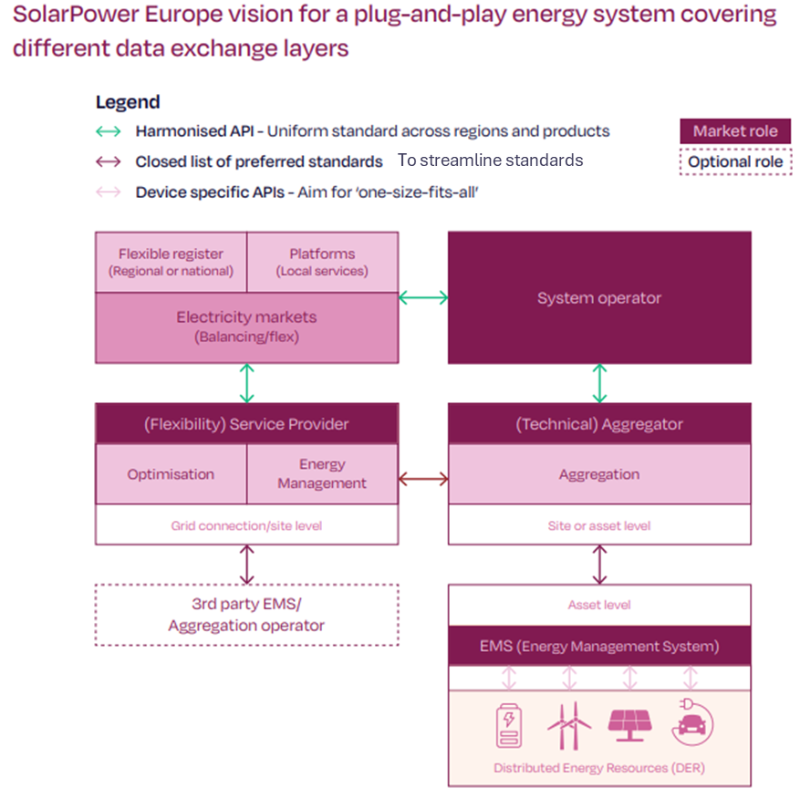
End to end demand Response interoperability
(+) Data harmonisation is now clearly required for standard flexibility products, including FCR.
(+) The Electricity Balancing Guidelines (EBGL) amendment now calls for harmonised data interfaces for balancing markets, using ETSI-CEN-CENELEC standards as asked by SolarPower Europe and aligned with D4E expert recommendations.
(-) System operators should refrain from burdensome data requests for distributed assets, only if the data is truly necessary. System operators should either use aggregated data from service providers or ask for standardisation if they need more detailed data.
(-) PCS and data interfaces related to power control systems (PCS), when activating FCAs, are still missing from the text
(-) The current text still refers to national standards for data exchanges in national products. Member States using local standards should justify them against equivalent ETSI-CEN-CENELEC standards.
Note: Regarding the work to be done on the Implementing Regulation, there are gaps, particularly the lack of provisions for downstream data exchange with technical aggregators/DER operators and end devices, as originally proposed.

Slide 144
Harmonised prequalification for all demand response products
Union-Wide Methodologies Impact: (Article 21) Within 12 months after the entry into force of this Regulation, ENTSO-E and EU DSO entities shall develop a proposal for a Union-wide methodology for further simplification of the product prequalification processes. The proposal shall identify cases where product prequalification can be replaced by product verification and shall describe simplifications in the processes, requirements and activation tests where applicable, including specific simplifications where at least a potential SPU or SPG exclusively consists of small controllable units or controllable units that are identical to controllable units being part of other SPUs or SPGs previously prequalified by any SP.
Harmonisation alignments: (Article 32 and 38) Mention that there *will* be harmonisation of local product attributes, starting in three years. But the Code does not foresee harmonisation of local product requirements (Art. 39). And the table of Equivalences is meant to be national, not European-wide (Art. 16).
Assessment:
(+) It is great to see that a coordinated, simplification work is foreseen for all product validation.
(+/-) But will this work in practice if the DR NC doesn’t require System Operators to harmonise product requirements, such as those needed for V2G EV/EVSE interoperability required under the RfG NC, for example?
(-) The execution timeline has been extended, and harmonisation work is largely deferred to future methodologies, which will only begin once code implementation is underway, raising concerns about when Member States will align. → Harmonisation of product validation, attributes, and requirements should start now.

Slide 145
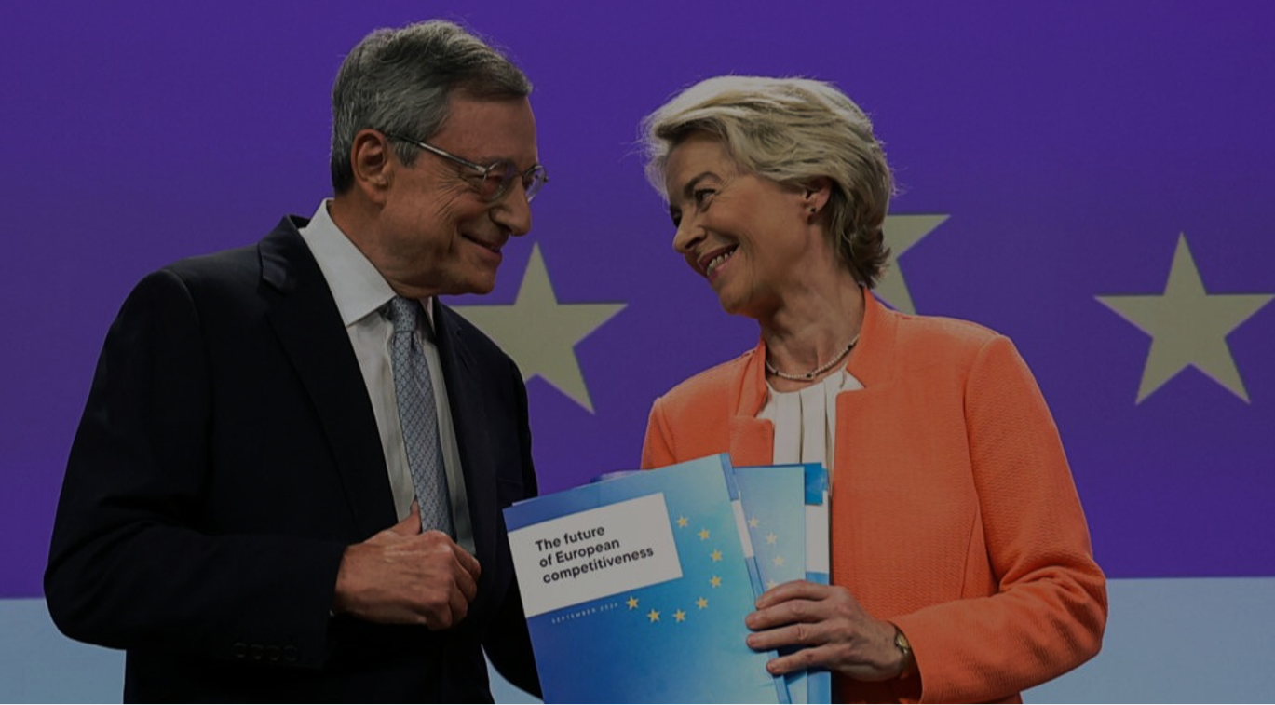

Three European policy goals supported by harmonisation of distributed asset requirements with hardware implications (e.g., interoperability requirements).
  Single Market integrity & industrial competitiveness: fragmented technical requirements applicable to distributed assets create 27+ compliance paths, which increases compliance challenges with the upcoming New Product Liability Directive. Standardized requirements enable European manufacturers to compete globally through economies of scale.
  Consumer affordability & lower electricity bills: Fragmentation drives up costs, passed to consumers purchasing EVs, heat pumps, and residential batteries. Fragmentation prevents the scale-up of demand response across borders, limiting opportunities for all electricity consumers to reduce their bills through demand response.
  Energy transition: Affordable, scalable distributed assets and demand response are essential for renewable energy targets and electrification goals.

Slide 147
Demand Response &
Congestion Management
Ljubljana October 2026

Slide 148
Demand Response
Policy Recommendations
Market-Based
Framework
Full implementation of Article 32(1) of the Electricity Directive ensuring flexibility procurement to be conducted through “transparent, non-discriminatory and market-based procedures”.
Neutral Third-Party Local Market Operator
Ensure neutrality, impartial market administration and consumer-centricity while preserving the roles and responsibilities of MO and TSO, reducing the risk of conflicts of interest while promoting transparency and trust in the market.
Interoperability between Wolesale Markets and Local Flexibility Markets
Ensure complementarity to wholesale markets, balancing and ancillary services through effective coordination across timeframes.
Prevent double procurements, allow sequential offering in different markets & simultaneous offerings (linking) as multiple revenue streams ensure a business case for service providers

Slide 149
Congestion Management
Assessment of ENTSO-E’s Market impact criteria
Criteria we support
1. Impacts on market liquidity, price formation and transaction costs across market timeframes
2. Investment stability. Impact on producer surplus and profitability for generation, storage, demand response
3. Affordability and impact on overall costs for consumers
Criteria that require further consideration
4. Impacts on the level of harmonisation vs. regional/national flexibility of power market design and implementation
5. Cross-border distributional effects

Slide 150
Congestion managemnt
Criteria that should be included or developed
Robust design and mitigation of potentially distortive behaviour
Any measures that strengthen incentives for local flexibility must be designed within this robust regulatory framework, supported by clear rules and effective monitoring,
preventing distortive behaviour at the local supply and demand level.
Proportionality, simplicity and feasibility
Any measure must be technically feasible, administratively simple and its complexity proportionate to the
problem it seeks to address. Reject theoretically optimal but practically unworkable solutions.

Slide 151


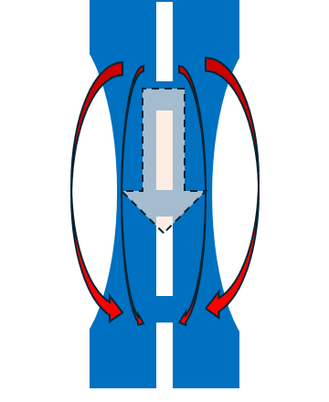
Summary of the main stakeholder’s views on the future challenges for DR and CM
Market-based framework for procurement of local services
Congestion management and other wholesale markets
Coordination between system operators
Regulatory framework – roles and barriers
Interactions between local flex and other wholesale markets
Observability and controllability​
European harmonisation vs national implementation
Remuneration of bids used for CM
TSO-TSO and TSO-DSO communication and coordination
Locational signals – local vs system wide challenges
Flexible connection agreements and other CM
Reliability and security
Local market operator role
Standardised data exchange and interoperability
Markets vs physics
infinite internal, limited X-zonal trade
70% target, supported by RDCT
security concerns

Slide 152


Key challenge: flexibility and short-term markets
Flexibility services is an “umbrella” term.
But we also need to make sure that developments don’t take place in silos that the functioning of all the markets and processes together is efficient.
So, we have to go into each one of the existing markets and ask whether the rules are suitable for enabling DR, and also to ensure that (new) market-based procurement processes are established.

Slide 153
Further discussion on challenges for DR and CM
Market fragmentation challenge
Efficient dispatch challenge
TSO-DSO Coordination challenge
Challenge: reconciliate markets and physics
  Inefficient cross-timeframe interactions.
  Several (energy) markets operating at the same time (close to real-time) in an uncoordinated manner, which creates inefficiencies and limits value stacking.
  Trading between market participants “competing” with procurement of services by the system operators.
  ID market, balancing markets, and congestion management procurement are overlapping.
  =>The trading by the market participants could potentially worsen an issue that the system operators try to solve.
  Coordinated actions for congestion management and market delineation.
  No European regulatory framework on TSO-DSO coordination for congestion management.
  unlimited internal trade
  ⇒ security concerns
  ⇒ high loop flows
  ⇒ discrimination of cross-zonal trade
    ⇒ apply min 70% target, ensured by:
    building infrastructure,
    splitting bidding zones,
    pay: virtual cap. & RDCT
    further security concerns,
    in particular at ID

Slide 154
Challenges
Capacity Calculation & Congestion Management
Backup slide
How to reconciliate markets and physics?
    unlimited internal trade
    ⇒ security concerns
    ⇒ high loop flows
      ⇒ discrimination of cross-zonal trade
      ⇒ applying min 70% target, ensured by:
      build transmission infrastructure, and/or
      split or adjust bidding zones, and/or
      pay: virtual capacities, RDCT-supported
      ⇒ further security concerns, in particular at intraday time frame
RDCT: Redispatching and Countertrading

Slide 155
7. Key Future Challenges in Compliance and enforcement
(ACER FF slides for reference – not presented)
Stakeholder interventions (0.5h)
ACER contribution & discussion (0.5h)

Slide 156
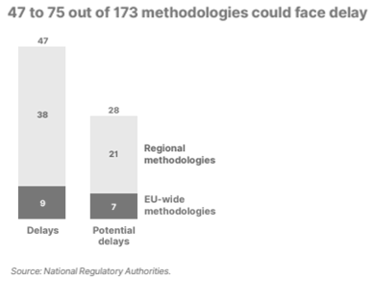
Background
Why an ACER Recommendation to the European Commission?
The ACER Recommendation responds to the European Commission’s (2024) request for advice on how to strengthen the regulatory framework to reduce delays, with a focus on enforcement, governance and incentives.
Implementation delays identified in 2024
Major delays occurred in the implementation of methodologies* defining market operations, both regional and EU-wide
Why this matters:
Costs
Trust
Energy transition
…
ACER 2024 Market Integration Report
* The EU electricity market framework includes network codes and guidelines and detailed rules - terms and conditions or methodologies (TCMs). TCMs set out key responsibilities for TSOs, NEMOs, ENTSO-E and regional coordination centres (RCCs).
Notes:
Delays can greatly affect consumers’ cost, especially for projects with substantial welfare effects, hindering the EU energy market’s proper function
Delays undermine trust in the regulatory system and slow down the energy transition.

Slide 157
Challenges
ACER’s Recommendation identifies challenges in three main areas:
TCM deadlines are often unclear or lack sufficient justification, making it difficult to track progress.
IMPLEMENTATION
COMPLIANCE FRAMEWORK
The decision-making process for addressing non-compliance by ENTSO-E and RCCs has room for improvement.
The current enforcement processes could fall short when tackling delayed implementation or failure to comply of all TSOs or all NEMOs joint tasks and collectively fail.
.
COLLECTIVE OBLIGATIONS

Slide 158
Way forward
ACER recommends that the European Commission strengthen the regulatory framework by:
Strengthening the framework
02
in the ACER Regulation to ensure non-compliance by ENTSO-E and RCCs is addressed consistently and effectively.
Assessing how to further improve the framework for collective obligations
01
(i.e. in the case of potential non-compliance of all TSOs and all NEMOs obligations).
Improving implementation and monitoring
03
introducing clearer deadlines and reporting requirements to reduce delays.

Slide 159
Order of Interventions
  EURELECTRIC (2 slides) – 5 minutes - ?
  SmartEN – 10 minutes – Guro Grotterud
  ENTSO-E – 10 minutes – Oliver John
  NEMO committee – 10 min - Rafael
  ETE – 5 min – ?
  Total 40 minutes

Slide 160

What are the key challenges of market coupling governance ?
Governance
A multi-level governance at risk of inefficiencies in an increasingly integrated market
Prioritisation and implementation timelines can be improved:
Overdue legal requirements should be prioritised over long-term projects with unclear benefits under real market conditions.
Fragmentation through uncoordinated national decisions: increase in local remedies to energy cost and grid issues affect the level playing field on coupled markets.
Ill-designed national policies (e.g. Italian energy decree, produce-and-forget CfD designs) have an impact on the internal electricity market.
Changes in injection tariffs for generators based on different national methodologies distort competition on the coupled markets.
Misalignment of policy and market priorities: MP constraints are not always considered in project design and implementation.
More structured involvement is needed to increase buy-in and to avoid tedious ex-post adjustments.
Project-by-project assessments can miss the bigger picture.
Accountability gaps in market coupling governance: difficult balance between local entities’ priorities and collective interests.
The oversight of regulated entities can be disconnected from their relevance for market coupling collectively.
Oversight arrangements need to ensure effective accountability and incentives to deliver projects improving net benefits.

Slide 161
Proposals for an improved market coupling governance
Governance
Prioritisation and timelines can be improved
Projects with the highest return, largest market acceptance and/or easiest implementation timeline are prioritised and implemented.
Immediate delivery: overdue legal obligations (ROSC), transparency and implemented-but-incomplete methodologies.
Near-term improvements: intraday capacity, prequalification harmonisation, coordinated remedial actions and fallback arrangements.
Longer-term design: evaluation and/or investigation of major design changes (e.g. co-optimisation, FB IDCT, fundamental market-coupling governance changes).
Misalignment of policy and market priorities
Involve MPs across policy stages: EBGL 2.0 discussion is good example of MP involvement from the problem definition stage. This also matters all the way through implementation.
Assess the net benefits of coupling projects, considering interactions across the market sequence.
Accountability gaps in market coupling governance
Central oversight, coupled with sufficient accountability, can be justified where current arrangements are not effective.
Stronger ACER role in coordinating investigations into network incidents to ensure a transparent, objective and inclusive process, as well as timely data collection.
Ensure transparency on ACER decision-making: publish detailed minutes and votes of ACER BoR meetings.
Fragmentation through national interventions
Strengthen governance to identify and tackle cross-border impacts of national decisions.
More coordination can be a first step: open exchange about potentially harmful national measures.

Slide 162
Compliance and enforcement
MESC Conference, Ljubljana, 8-9 October 2026
Guro Grøtterud
guro.grotterud@nodesmarket.com

Slide 163
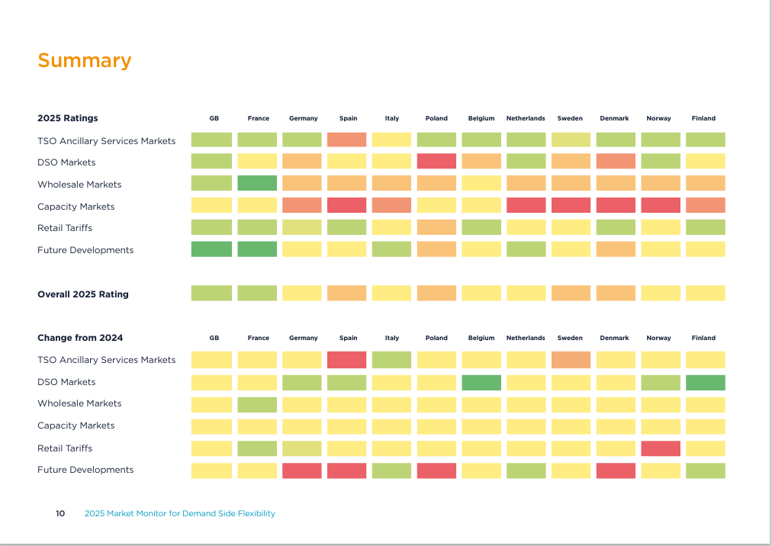
Market Monitor 2025
DR should access all markets
DR lacking access to many markets
Although regulation requires access, implementation remains limited
E.g.: independent aggregation, market based congestion management

Slide 164
Independent aggregators access to wholesale markets

Slide 165
Local Flexibility Markets in Europe
NODES closed markets: in GB, DE, SE
Piclo
Great Britain
Ireland
Italy
Portugal
Lithuania
Slovenia
In grey: closed markets
Notes:
Although we notice that there are not many DSOs that use market based flexibility, there are existing, open markets. Four of SmartEn’s members provides, and have provided, market platforms in many countries in Europe.
NODES has ongoing markets in Norway, Sweden, Belgium and Finland (starting soon in Estonia).
Epex Spot has open markets in the UK and in Switzerland, and has connected its intraday wholesale market to GoPacs
Electron has four markets in GB
Piclo’s platform is currently used in GB, but also in Portugal and Italy
Markets tend to be pilots that close after a year or two – not serious attempts.
The countries in grey, in addition to the EPEX Spot’s Enera project, are markets that have closed down. This – initiatives closing down after a few years, is something that ACER has pointed to as frequently happening with DSO flexibility initiatives.

Slide 166
Timeline
2019: Clean Energy Package
  DR market access
  Independent aggregators
  Preference for market based procurement of congestion management services
2022: Framework Guideline for NC DR
2025: ACER proposal for NC DR
2026: still waiting for the NC DR
When can we expect implementation of applicable requirements?

Slide 167
How to adress lacking implementation?
With the support of DRESG, ACER reports on implementation and best practices
Harmonisation may come through:
  European methodologies (NCDR – suggested by SO organisations to ACER – hopefully with strong stakeholder involvement)
  IR on Interoperability
All topics not covered:
  Combination of tools at SO’s hands and correct incentives
ACER’s current suggestion for enforcement concerns ENTSO-E and RCCS – how to include DSOs?

Slide 168
Future key challenges on governance and compliance
October 2027

Slide 169
Future challenges on governance
Considerations on governance
Evolving the governance without compromising the security and resilience of the system.
Ensuring alignment with the roles and responsibilities of the different parties involved.
Defining not only the target but also implementable pathway(s).
Notes:
Main message: we are delivering today … so please consider for any governance proposal …..

Slide 170
Future challenges on governance
EU internal energy market saves consumers €32 billion in Day Ahead alone
Go live of the 15-Minute Market Time Unit in the Day Ahead Market
15-minute MTU went live on 30 September 2025 (trading day) .
Intraday Gate Closure Time Moved to 30 Minutes Before Real Time.
Uninterrupted continuation of day ahead market coupling across all participating bidding zones.
amended IDCZGOCT methodology was submitted by all TSOs in July 2025.
Market design reform implementation
completion of over one year of pan European testing
first operational go lives of the 30 minute gate closure occurred on 14 January 2026.
15min
Governance on the DA and ID Markets
Market coupling is critical infrastructure for the TSOs in balancing and dispatching the power system.
MCO function must be a joint responsibility of TSOs and NEMOs, covering technical, governance, and IT system aspects.
Notes:
Main message: Market coupling is working today and is critical infrastructure for TSOs … so please consider that MCO must be a joint responsibility in all aspects

Slide 171
Future challenges on governance
Regulatory framework to foster the implementation
Clear regulation, smooth regulatory decision process with the engagement of all concerned parties are the factors for successful and timely implementation.
Implementation timelines are influenced by regulatory developments, methodological maturity, stakeholder alignment and technical feasibility – these are not sufficiently taken into consideration so far.
A comprehensive assessment of the factors influencing implementation timelines would help to define robust deadline.
Notes:
Main message: To deliver fast we need: clear regulation (ambiguity on the regulation due to misalignments between EU and MS like the principles to define structural congestion, cost sharing keys, or the need or not to have one or several methodologies today to monitor the 70% …. Do not help)
TSOs do have the role to maintain operational security: so between time and quality (secure operation)… no question about the choice

Slide 172
NEMO Committee presentation for MESC „Conference on future electricity market challenges”
8/10/2026

Slide 173
Future key challenges – NEMOs perspective – governance and compliance
Any governance amendments in network codes must comply with the Electricity Regulation provisions.
NEMOs and TSOs to retain their operational responsibilities in line with the current Regulation.
Transparency of price formation is key. Need to strike a balance between enabling stakeholders to understand how prices are formed, and adding new complex requirements to the algorithms ( e.g. co-optimisation) which make prices less transparent.
New requirements should be added only if they demonstrably improve social welfare with reasonable cost.
Pre-coupling and post-coupling processes: Where appropriate, EU authorities could consider further harmonization of common TSO processes.

Slide 174
Future key challenges – NEMOs perspective – governance and compliance
Feasibility of regulatory deadlines → past experience has shown that such deadlines, without full involvement of NEMOs and/or TSOs which who are ultimately responsible for their delivery face significant challenges that are possibly not fully foreseen on regulatory/political level. NEMOs would welcome earlier involvement in the whole process.
Project prioritization exercise with clear criteria and a transparent implementation → to achieve policy objectives a project prioritization exercise would be seen as beneficial and could lead to a better project timeline with more realistic regulatory deadlines.
Legislative/regulatory stability → New requirements introduced by new legislative/regulatory acts, sometimes even with conflicting goals and outcomes, lead to further challenges, also in relation to the potential coupling with countries outside of the EU → predictable regulation might lead to better outcomes.
Increasing regulatory requirements on SDAC and SIDC may shift part of the trading to OTC. OTC markets deliver less social welfare than market coupling and decrease price transparency, entail a less efficient use of transmission networks and of production and consumption assets.

Slide 175
8-9 October 2026
ISKLJUČIVO PRIMATELJU
Market Stakeholder Committee
Ljubljana

Slide 176
Governance, compliance and enforcement
ISKLJUČIVO PRIMATELJU
Aim: consult early, develop in cooperation, make EU decision-making more effective.
Strengthening the decision-making powers of central institutions should be prioritised over individual stakeholders to block progress.
Regulators, TSOs and NEMOs should have greater flexibility to suggest improvements to regulatory frameworks following implementation, allowing lessons learned to be incorporated.
Early feasibility assessments and consultations with market participants, before legislative proposals, could help avoid regulations that are impractical or lack market insights.
Regional stress-testing of EU market-design proposals, especially for peripheral markets (SEE, Nordics, Italy or SWE). Market design is often lead by CWE/Core.

Slide 177
Conclusions
ISKLJUČIVO PRIMATELJU
Earlier stakeholder involvement is valuable only if it is early enough to shape the problem definition, analytical assumptions and design of solutions.
The MESC can shape design and implementation with clear mandates and timelines. This is essential if Europe wants market integration and system-cost reduction to be mutually reinforcing rather than developed in separate regulatory silos.

Slide 178
Summary of key messages from stakeholders
Ensuring coordination of national decisions.
Reshape oversight and the investigation role of ACER ensuring accountability.
03
04
COORDINATION
OVERSIGHT AND ACCOUNTABILITY
Earlier engagement in policy discussions to ensure a smoother decision-making process; flexibility to propose improvements.
02
05
POLICY DISCUSSIONS
MARKET INTEGRATION
Reap the benefits of market integration.
01
06
MESC
PROJECT TIMELINES
YOUR TITLE
Private equity has successfully attracted the best and brightest in corporate America.
Improvements on how the project timelines are set, considering feasibility and prioritisation.

Slide 179
8. Discussion & way forward

Slide 180
How to involve stakeholders?
Complementary formats to strengthen stakeholders’ engagement
Implementation experience roundtables
Challenge & Solution workshops
Success stories & Innovation forums
Sharing experiences and lessons learned from different implementation approaches
Focus:
Implementation roadmaps and milestones
Organisational, technical, and regulatory challenges
Interpretations of legal requirements
Lessons learned and mitigation measures
Identifying implementation challenges and collective practical solutions
Focus:
Open legal implementation questions and uncertainties
Regulatory and market design barriers
Coordination needs
Requests for feedback, support and solutions
Showcasing achievements and opportunities and identifying good practices
Focus:
Successful implementation initiatives and pilot projects
Innovative solutions (some developed to meet legal requirements)
Good practices, transferable lessons and new opportunities
Solutions enabled by the upcoming legal developments (e.g., NCs)
COLLECTIVE PROBLEM-SOLVING
KNOWLEDGE SHARING
GOOD PRACTICES

Slide 181
Challenge areas for the IEM
Compliance & Enforcement
Market & Grid access
Cross zonal Capacity & system design
Market Design
Governance

Slide 182
Stakeholder committees cover timeframes
Regulation | Market / timeframe | Governance | Market design | System Design & CZC Calculation | Market & grid access | Compliance & Enforcement
FCA | Forward
CACM | Day ahead
 | Intraday
EB | Balancing Capacity
 | Balancing Energy
 | Imbalance settlement
DR | ROSC / RDCT
 | DSOs CM
MESC
EBSC
DRESC
SO&GC ESC

Slide 183
Targeted expert groups cover areas
Regulation | Market / timeframe | Governance | Market design | System Design & CZC Calculation | Market & grid access | Compliance & Enforcement
FCA | Forward
CACM | Day ahead
 | Intraday
EB | Balancing Capacity
 | Balancing Energy
 | Imbalance settlement
DR | ROSC / RDCT
 | DSOs CM
Adhoc group on market design
Adhoc group CC & CM
Ad-hoc group on market & grid access rules

Slide 184
Targeted expert groups covering specific topics
Regulation | Market / timeframe | Governance | Market design | System Design & CZC Calculation | Market & grid access | Compliance & Enforcement
FCA | Forward
CACM | Day ahead |  |  |  | Fallback procedures
 | Intraday
EB | Balancing Capacity |  | BC market integration
 | Balancing Energy
 | Imbalance settlement |  |  |  | Harmonise imbalance settlement
DR | ROSC / RDCT
 | DSOs CM

Slide 185
How to work on further work on the challenges?
Option 1: From 1 > 3 Stakeholder Committees
MESC for Forward, DA, ID
  Focus more deeply on market topics
Balancing stakeholder group
  Rebrand into Balancing Stakeholder Committee
Demand response stakeholder group
  After DR NC adoption create Demand Response Stakeholder Committee
Option 2: Targeted expert groups for specific topics or for broad areas
Keep existing structure of MESC & stakeholder groups (EBSG, DRESG)
Create ad-hoc targeted expert groups (like the current fallback group) to discuss specific topics or areas

Slide 186
Future challenges
Capacity Calculation and Congestion Management (backup slide ZV)
MESC Public website here
 | CC | CM
Eurelectric (CC&CA) Eurelectric (CM) | Nodal pricing would create massive uncertainty: more targeted investment signals e.g. through connection charges or targeted bidding zone reviews can achieve similar objectives while preserving market confidence. Sufficient CZC also requires physical grid build-out: faster expansion including tackling bottlenecks within BZs requires investments, faster permitting, digitalisation. Lack of CZC: unequal progress towards the 70% target in DA and issues resulting from uncoordinated CC approaches between regions and across timeframes. Implement FB in IDAs, ensuring that potential impacts on IDC and BAL are accounted for and minimised through accompanying measures. Transparency on CC (inputs, remedial actions, capacity reductions). Geographical extension of MC: SDAC/SIDC | RA coordination: key to lowering system costs and increasing CZC. Local flexibility markets should not negatively affect wholesale markets. RA coordination is delayed by cost considerations. Pragmatism should be considered. Could requester-pays principle be a way to start things up? Implement sharing of remedial actions (ROSC, RDCT) to reduce the cost of congestions.
 |  | Treatment of balancing bids used or withheld by TSOs for congestion management purposes distorts balancing price formation. Strengthen TSO-DSO communication for system security, congestion management & operational planning. Implement RDCT coordination: it will improve CM and CZC, reduce costs
NEMO Committee | Extensions of the market beyond EU (EnC, UK, CH); Application of FB allocation in IDAs; Potential changes of times and freq. of IDAs.
ENTSO-E (CC&CA) ENTSO-E (CM) | When increase CZC, consider: reg/seasonal variations, feasibility&costs, impact on system operation, dev, maint…gains, priorities. ID70: appl. with virtual capacities – security concerns; The Regulation to allow the CCMs to define timeframe-specific implementation. Further refinement of criteria to exclude RAs from capacity calculation needed. Recalculation to remain possible as last resort measure (outages, forecast changes…) IVA to remain safeguard and not limited to accepting or rejecting coord. actions by RCCs Geographical expansion of SDAC and SIDC FB for IDA | ENTSO-E Position Paper on Market Design Options: Slow and insufficient grid development Increasing gap between market outcomes & physics Increasing congestions and associated costs Integration of new renewables capacities and flexibilities Shorter time to deal with higher variability & uncertain cong. patterns Risk of insufficient grid-serving (including balancing) system flexibility Effectiveness of relying on remedial actions to implement min 70% The principle behind the 70% framework (achieve market integration & avoid undue discrimination between int. and XZ exchanges), remains fundamental.
IFIEC | 70%MinRAM: Necessary proxy target to evolve towards and achieve market integration Need for transparency and as little as possible exceptions to the algorithm (cf. IVA) Integrate all BZBs of Europe (also CH, GB) in the algo, ensure optimal allocation of flows (FB?; 20% Fuaf) | Infrastructure lag, locational mismatches, reliance on expensive RD Management of physical grid leads to redispatching -> System costs increase, and are borne by grid users who are already struggling Polluter pays principle for freeriding on grids
ETE | CC - potential inter-regional harmonisation long-lasting, politically acceptable cost-sharing solution to be agreed- key to unlock CZC Expand the internal energy market (GB, CH, Energy Community) with concrete plans Strengthen transparency Phase-out 70% derogations | Clarify the role of market-based redispatch (or congestion services in general) in relation to wholesale markets Develop technology-neutral, competitive procurement of congestion-management flexibility.

